Slide 1
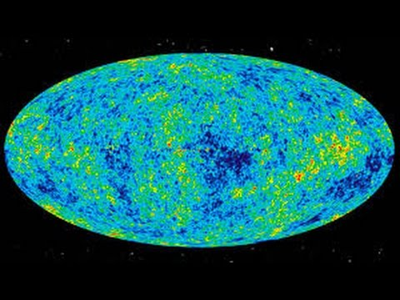
The Expanding Universe

Slide 2
Cosmos Episode 1
WRKST
http://www.dailymotion.com/video/x3mozkp
Netflix.com
http://www.disclose.tv/action/viewvideo/176837/Cosmos_A_Spacetime_Odyssey_Season_1_Episode_12_S1E12_The_World_Set_Free_Full/
http://www.fox.com/watch/183733315515

Slide 3
ASTRONOMY & COSMOLOGY
Study of the Universe

Slide 4
How did the Universe form?
BIG BANG THEORY: The Universe began when a dense point of matter exploded 13.7 billion years ago.

Slide 5
Supporting Evidence
Hubble Telescope: Discovers the “Red Shift”: All of the galaxies are moving away from each other.
The Universe is still EXPANDING.
As stars move farther away, their light gets shifted toward the red wavelength.

Slide 6
Formation of Galaxies
Galaxy: Hundreds of billions of stars.
3 Types of Galaxies:
Irregular: Just like it sounds
Elliptical: Central Disk, oval-shaped.
Spiral: Central Disk with “arms”
Our galaxy is the MILKY WAY
Galaxies are the result of left-over material from the Big Bang.

Slide 7
Milky Way: Spiral Galaxy (Central disk with “arms”)

Slide 8
Elliptical Galaxy (oval-shaped)

Slide 9
Irregular Galaxy

Slide 10
Birth of Stars
Birth: Huge clouds of gas called nebula
Ingredients: Nuclear fusion: H to He.
Birth Weight: Larger the star, hotter the temperature.

Slide 11
Properties of Stars
Size: Dwarf, Main Sequence, Giant
Density: Bigger stars die out faster
Temperature: hotter stars – blue/white
cooler stars – yellow/red

Slide 12
Properties of Stars
Brightness (LUMINOSITY): Brightness of stars compared to SUN.
Higher Luminosity = More Energy Output.
Apparent Magnitude: Brightness of stars as observed from Earth.
Absolute Magnitude: Brightness of stars if they were all the same distance from the Earth.

Slide 13
6 “groups” of stars
Blue Supergiants (Very large and hot)
Supergiants (Very Large)
Red Giants (Large, but not that hot)
Main Sequence (Includes the Sun)
White Dwarfs (Small, but hot)
Red Dwarfs (Small and not very hot)

Slide 14
p. 15, ESRT

Slide 15
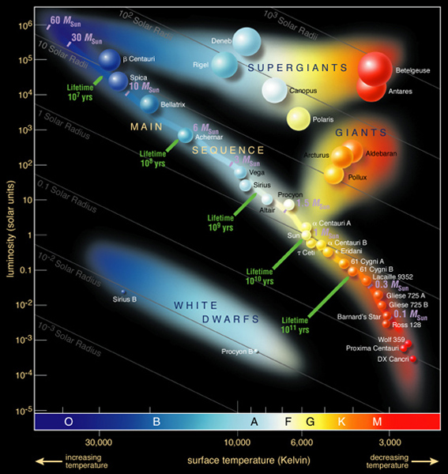

Slide 16
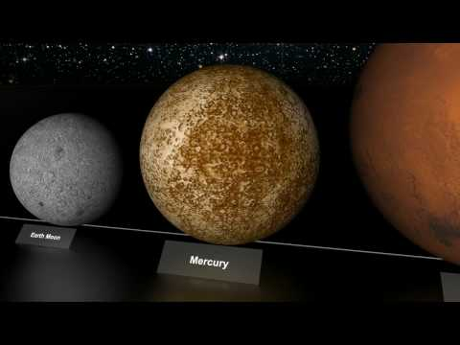
Video (size of stars)

Slide 17
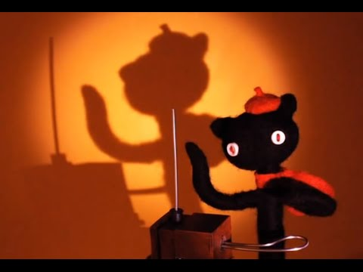
Star Song

Slide 19
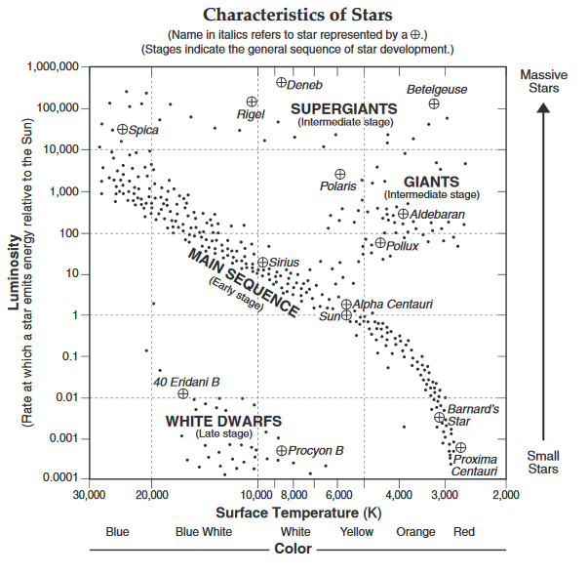
p. 15, ESRT

Slide 20
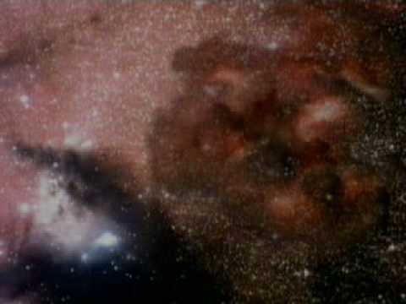
How are stars formed?

Slide 21
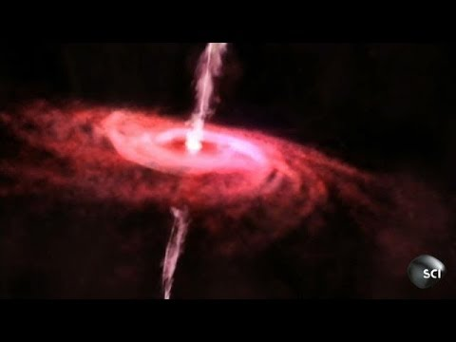
How are stars formed?

Slide 22
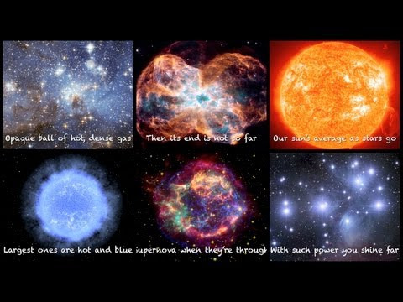
Twinkle Twinkle...

Slide 23
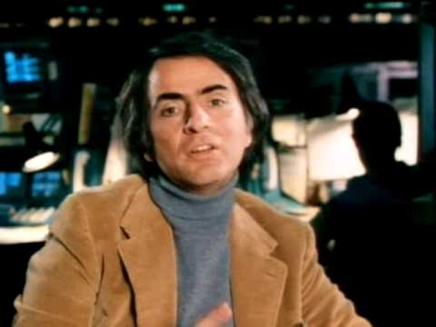
Video

Slide 24
Star Video
https://www.spacetelescope.org/videos/heic1118a/

Slide 26
Super Moon
http://www.space.com/34696-supermoon-science-nasa-explains-what-s-rare-about-luna-in-nov-2016-video.html

Slide 27
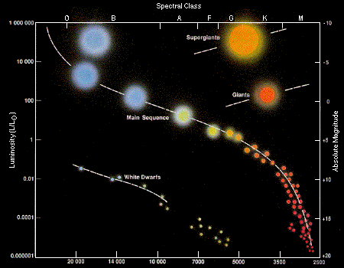

Slide 28
Birth of Stars
Can you describe in your own words the process of stars?

Slide 29
How far away distant galaxies are.
http://www.theatlantic.com/technology/archive/2012/05/how-do-we-know-how-far-away-distant-galaxies-are/257787/

Slide 30
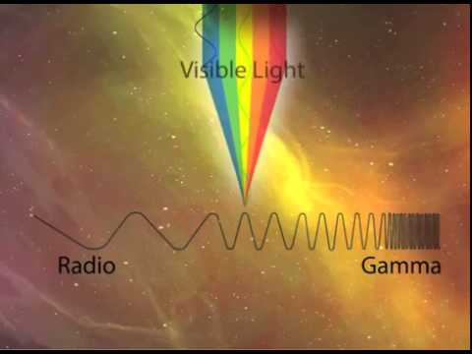
Light Video (Year of Light)
https://www.youtube.com/watch?v=_DbJSez1q2g

Slide 31
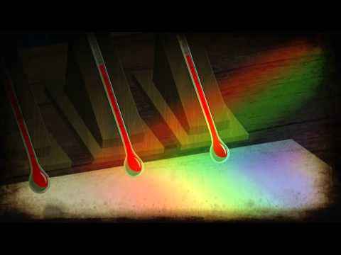
Cosmos: Hiding in the Light (5)
16:00, q. 12

Slide 32
P. 14 ESRT / Turn and Talk
EM Spectrum
Pass around Sun in different wavelengths
Which has a higher wavelength?

Slide 33
Planet Formation Video
http://www.nbcnews.com/science/space/radio-telescope-gets-best-ever-view-planetary-birth-n242741

Slide 34
OUR SOLAR SYSTEM
Contains the SUN, eight planets, their moons, and asteroids and comets.

Slide 35
Two types of planets
TERRESTRIAL: Earth-like, small, rocky crust.
Mercury: No atmosphere, many craters
Venus: Thick, hot atmosphere of CO₂
Earth: You see it everyday
Mars: Red dust and rock surface, Very cold

Slide 36
Mars

Slide 37
Venus

Slide 38
Jovian Planets: Very Large, gaseous, low density.
Jupiter: Giant Red spot, has 4 moons
Saturn: Rings (Moon dust)
Uranus: Tipped on its side, South Pole is pointed at the sun.
Neptune: Faint rings, very high speed winds.

Slide 39
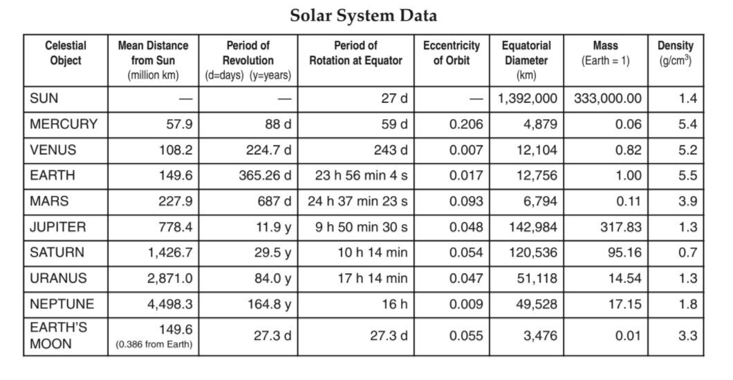
ESRT p. 15
Far from sun, year, day, orbit, size, mass, density

Slide 40
PLUTO
Is no longer considered a planet. It is a moon that escaped from Neptune.

Slide 41
Saturn

Slide 42
Comets
Balls of ice and dust. The center “nucleus” is surrounded by a hazy cloud called the “nucleus”, and is followed by a tail. Due to solar winds, the tail always points away from the sun.
Haley’s Comet appears every 76 years, last seen in 1994.

Slide 43
Meteors
Meteoroid: Chunk of rock floating in Space.
Meteor: A chunk of rock that burns/glows as it enters the Earth’s atmosphere. Also called a “Shooting Star”.
Asteroid’s are bigger than meteors.
Meteor Showers: occur when Earth travels through a cloud of space debris.
Meteorite: Chunk of space rock that does not burn up completely, and lands on Earth.

Slide 44
Geocentric Model
Ptolemy (Greek Astronomer) proposed that Earth is the center of the solar system.
Believed the Earth stays still, and that all objects (sun, stars, moon, etc.) revolved around us.
Did not explain planetary movements, nor the CORIOLIS EFFECT.

Slide 45
Heliocentric Model
Copernicus proposed that the sun was the center of the solar system.
The Earth revolves around the sun, and rotates on its axis (explains day and night).
Explains the coriolis effect.
Explains Retrograde Motion: Planets move from west to east, except when planet is passed by the Earth - causes the planet to appear to move backwards.

Slide 46
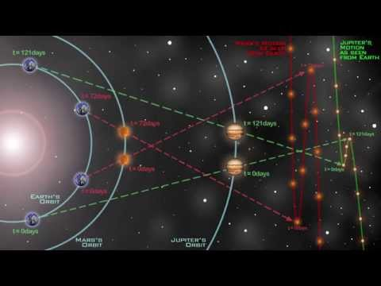
Video

Slide 47
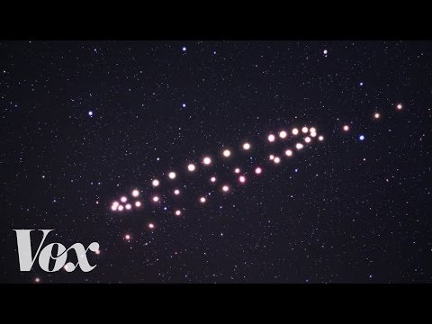
Better Video

Slide 48
“Retrograde Motion”

