Slide 1
Hydrology Video
http://pbskids.org/dragonflytv/scientists/scientist48.html

Slide 2
Hydrology
Hydro = water
ology = study of
The Study of Water

Slide 4
Evapotranspiration
All the water that evaporates and the water released by leaves of plants.

Slide 5
What happens to precipitation that hits the surface of the Earth?
There are only two possibilities:
Infiltration: Water soaks into the ground.
Runoff: Water runs over surface to lakes or streams.

Slide 6
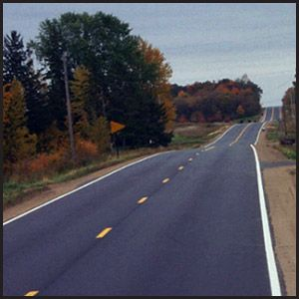
Infiltration is influenced by
Type of surface, Saturation of ground, slope, and vegetation.

Slide 7
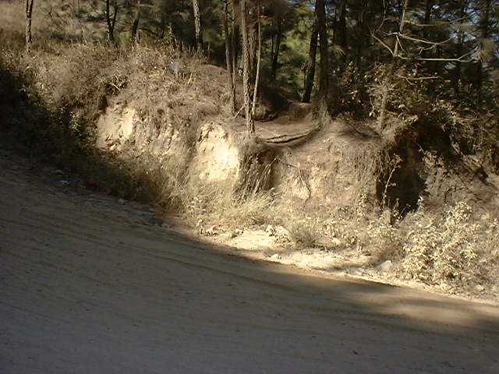
Water infiltration and soil

Slide 8
GROUND WATER
Zone of Aeration: Has air between particles.
Capillary Fringe: Area just above water table.
Water Table: Top of the zone of saturation.
Zone of Saturation: Soil is completely filled with water.

Slide 9
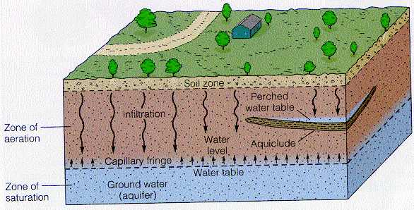
Ground Water (continued)
Regolith: Less permeable parent rock that makes up the bedrock of the area

Slide 10
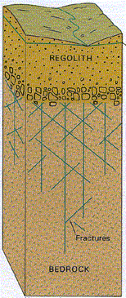

Slide 11
Factors Affecting Infiltration
Porosity: Percentage of open space in a soil.
Particle Size: Does not affect porosity.

Slide 12
Porosity (Continued)
Particle Shape: Round particles have more porosity than flat particles.

Slide 13
Porosity (continued)
Sorting: Sorted particles have higher porosity.
SORTED
NOT SORTED

Slide 14
Porosity
Permeability: Rate at which water moves through pore spaces of soil or rock.
Impermeable: Water can not enter. (examples: solid rock, pavement, clay)

Slide 15
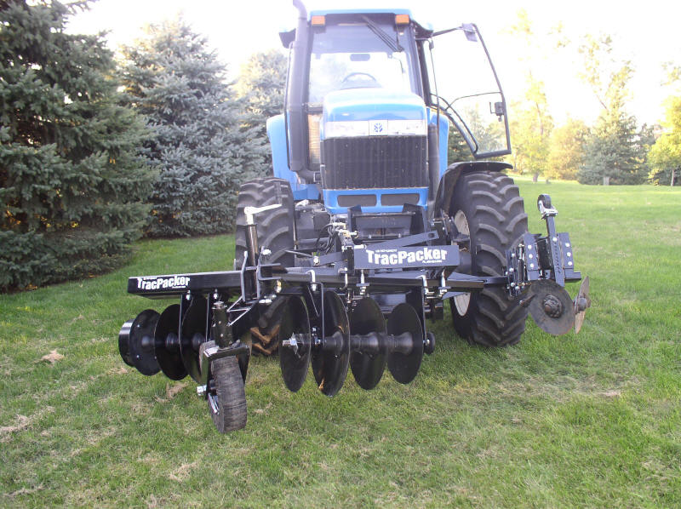
Porosity
Packing: Packed soils have less porosity.

Slide 16
Simulation
http://www.glencoe.com/sites/common_assets/science/virtual_labs/CT02/CT02.html

Slide 17
Which has the greatest permeability?
(turn and talk)

Slide 18
Factors Affecting Permeability
Particle Size: Larger grains are more permeable than small.
Particle shape: Rounder particles have higher permeability.
Sorting: Sorted soils are more permeable than unsorted.
Packing: Packed soils have low permeability.

Slide 19
Permeability of Soils

Slide 20
Capillarity
Upward movement of water through soil.
Capillary Action: Water sticks to small grains (cohesion).

Slide 21
Surface Area and Capillary Action
More S.A. = More C.A.
Water retention: Water held in pore spaces.

Slide 22
Capillarity continued
Particle Size: As soil size increases, capillarity decreases
Sorting: Sorted soils have low capillarity
Packing: More packing = more capillarity (to a point).

Slide 23
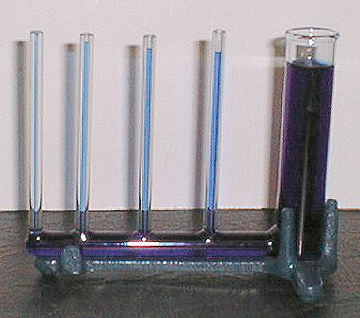
Capillarity

Slide 24
Volunteers

Slide 25
Which One Will Fill Up first!
http://www.eram.k12.ny.us/education/components/docmgr/default.php?sectiondetailid=17500&fileitem=1747&catfilter=447

Slide 26
Which One Will Fill Up first!
Which one will fill up the fastest?
Which one had the least amount of water in it? Why?
Put up 1 Finger - Red
Put up 2 Fingers - Yellow
Put up 3 Fingers - Green
Put up 4 Fingers - Mixed

Slide 27
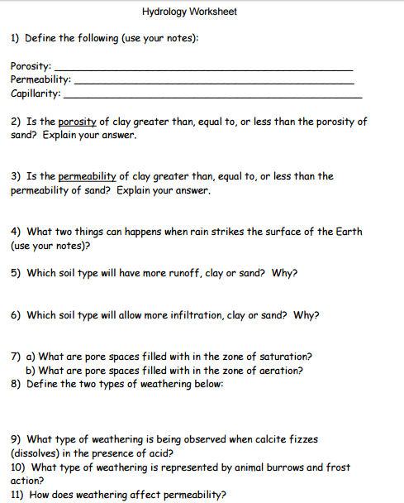

Slide 28
Porosity, Permeability, and Capillarity Lab
Figure A - Use your notes to find what porosity is. Pore Space is equal to the Porosity. State the relationship.
Figure B - Use your notes to find what permeability is. Time Required for 100 ml of Water to Flow Through is equal to the permeability. State the relationship.
Figure C - Use your notes to find what capillarity is. Height to Which Water Will Rise is equal to the capillarity. State the relationship.
Graph - Graph a line graph of A, B, and C in each of the Figures A, B, and C. Use different colors for A, B, and C.

Slide 29
