Slide 1
Isolines
An isoline is a line connecting points of equal value.

Slide 2
Examples of isolines:
Isotherms:
points of equal temperature
Isobar:
points of equal barometric (air) pressure
Contour:
points of equal altitude
Concentration of chemicals
Anything else you can get a value for.
(The weather channel loves isolines!)

Slide 3
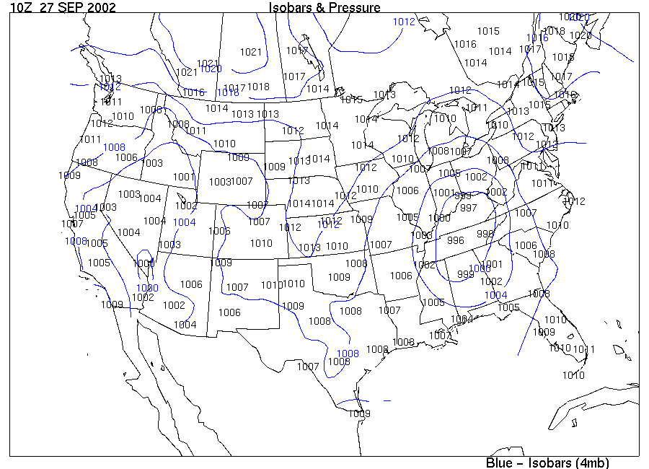

Slide 4
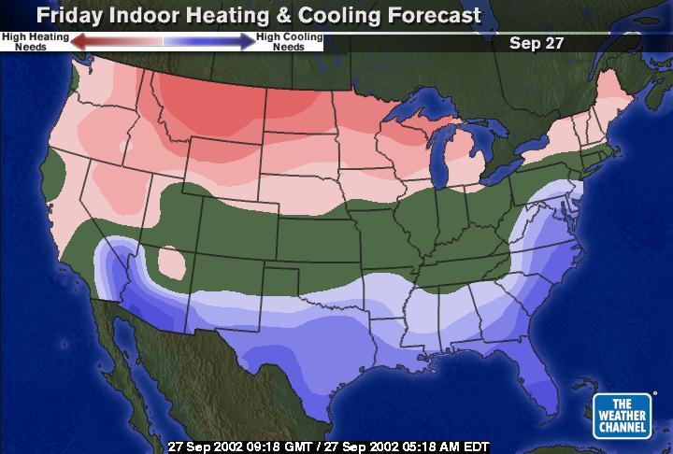

Slide 5
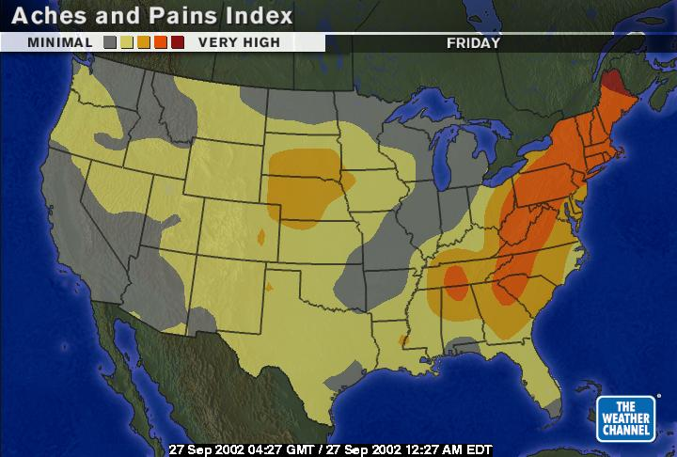

Slide 6
Rules for Drawing Isolines:
1. Isolines connect points of equal value.
5
5
10
10
10
10
15
15

Slide 7
2. Isolines are gentle, curving lines- no sharp corners.
5
5
10
10
10
10
15
15

Slide 8
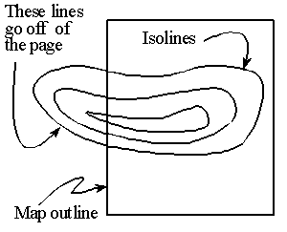
3. Isolines are always closed curves even though the map might only show part of it.

Slide 9
4. Isolines NEVER cross- this would mean that one point has two different values. Ex: one spot has two temperatures?
50 °
60 °
40 °
30 °
X
20°
Z
Y

Slide 10
5. Isolines usually are parallel. (They have a parallel trend.)

Slide 11
Visualizations of contour lines
http://geology.asu.edu/~sreynolds/topo_gallery/topo_gallery.htm

Slide 12
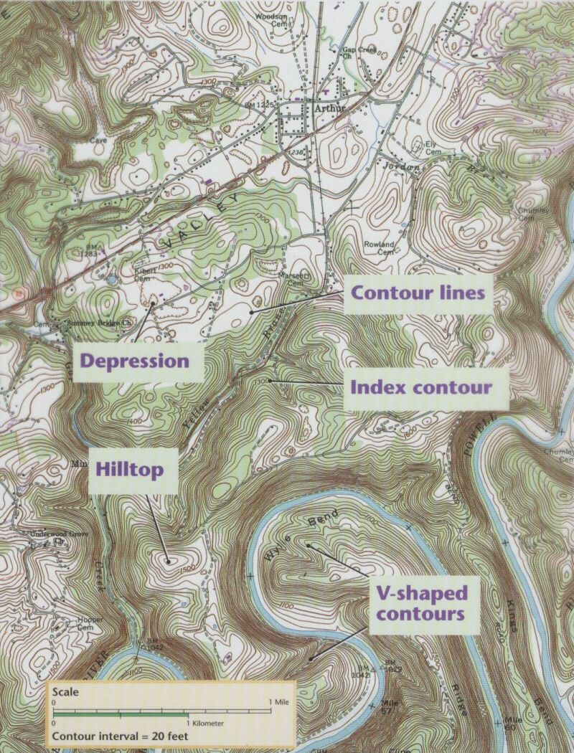

Slide 13
Gradient
Gradient shows how quickly the value changes from one point to another.

Slide 14
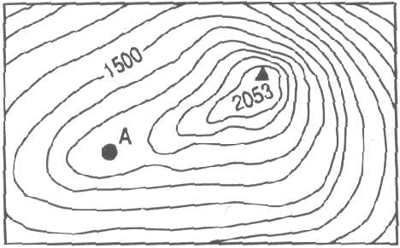
A steep (high) gradient changes quickly and the isolines are close together.
A gentle (low) gradient changes slowly and the lines are far apart.
Steep area
Gentle area

Slide 15
Making Contours worksheets
Worksheets can be printed from:
http://www.rcmurphy.net/Medina%202005/documents/Contours123.doc

Slide 16
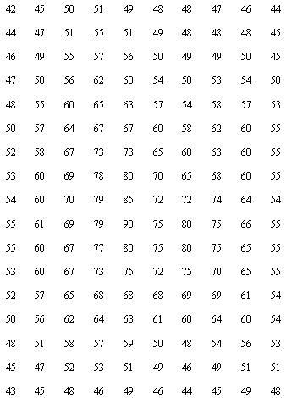
Highlight data points.

Slide 17
Fill in gaps in data.

Slide 18
Connect the dots.

Slide 19
Go on to the next value.

Slide 20
Making a Contour Map II

Slide 21
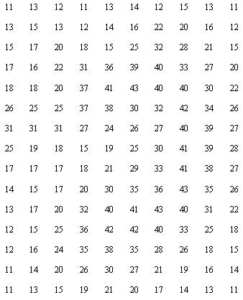

Slide 22
Drawing Contour Maps III

Slide 23
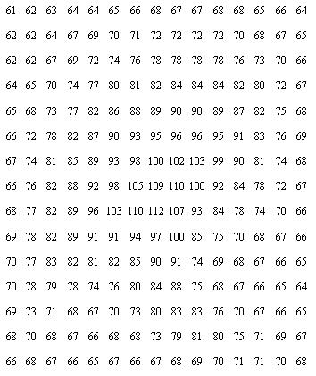

Slide 24
Gradient
Gradient shows how quickly the value changes from one point to another.

Slide 25
Practice
SHOW ALL WORK AND UNITS!!
Wilghise is climbing a mount that starts at sea level and reaches an elevation of 5000m. The distance traveled up the side of the mountain is 2km. What is the gradient of the mount.

Slide 26
Practice
Try the rest / Go over answers

Slide 27
Combine Skills (Scales/Isolines/Gradient)
Step 1: Identify the contour interval of the map.
Step2: Determine the elevation of each point, and subtract to find their difference. Record this value (use either ft or meter as your unit).
Step 3: Transfer the map scale onto a piece of scrap paper to measure the distance between the two points. Record this value (Use either km or mile for your unit.
Step 4: Divide your answer from Step 2 by your answer from Step 3.
Step 5: Round your answer to the nearest tenth, and include units (either m/km, or ft/mile).

Slide 28
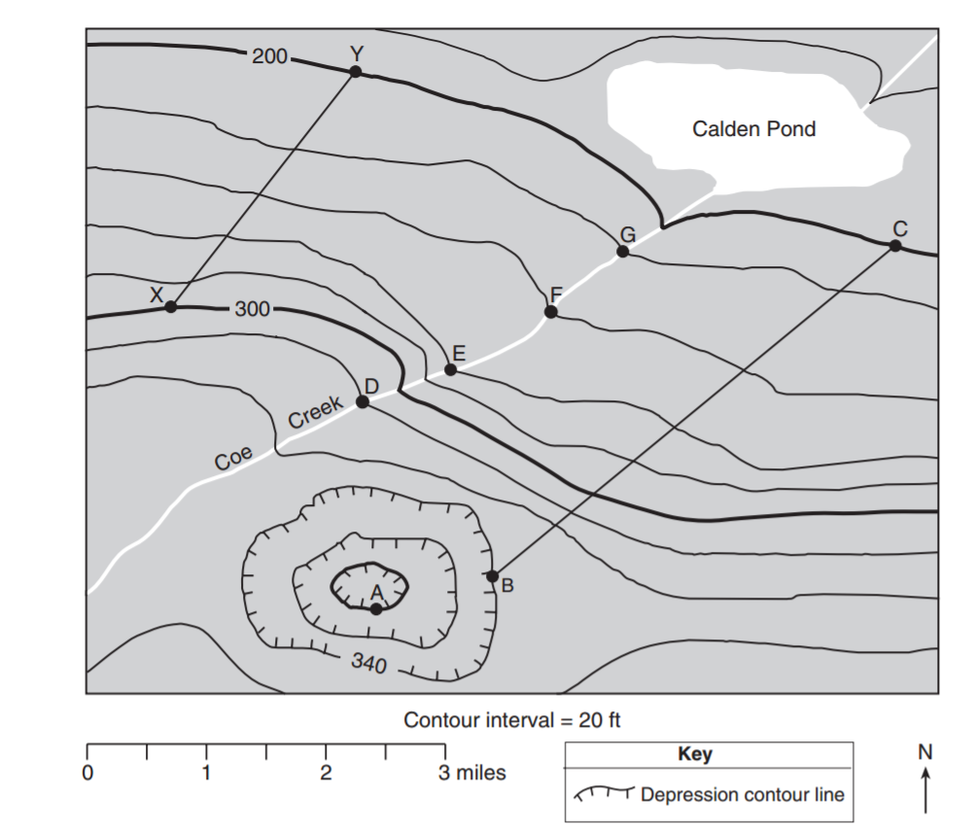
DIN
Calculate the gradient between x and y. Distance is 3 miles.

Slide 29
Profiles
Profiles are side views of the land
Place paper along contour map.
Mark the points where contour lines cross the paper. Record the elevation.
Place strip below graph provided.
Graph the points marked on the paper.
Draw a line connecting the points on the graph.

Slide 30
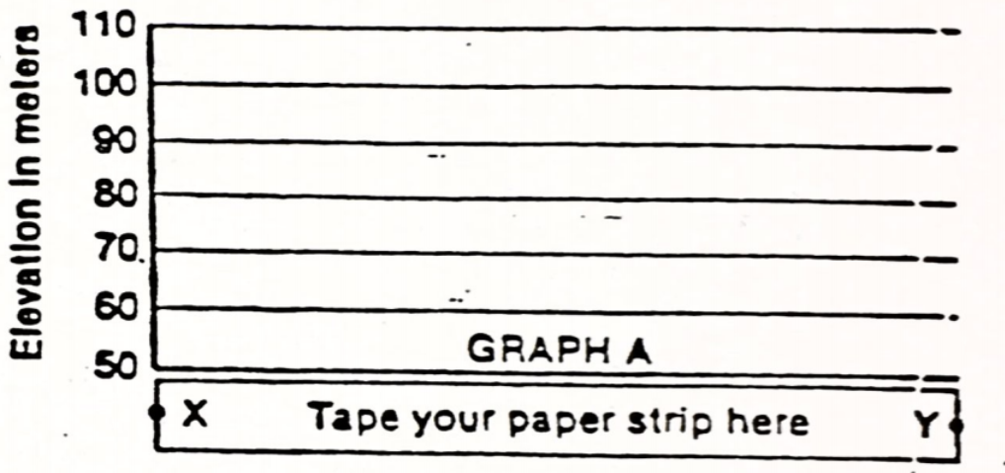
Profiles

Slide 31
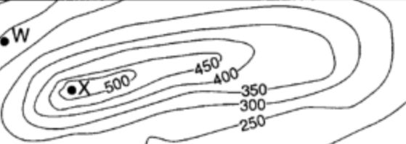
Turn and Talk
What is the highest possible elevation X could be?

Slide 32
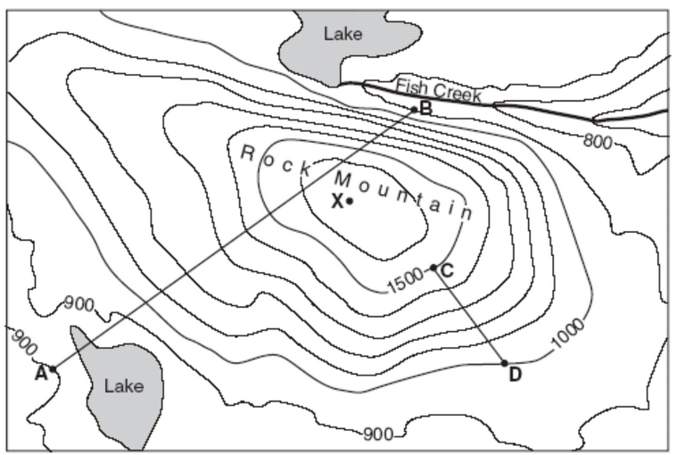

Slide 33
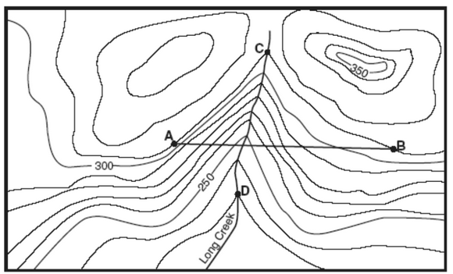

Slide 34
