Slide 1
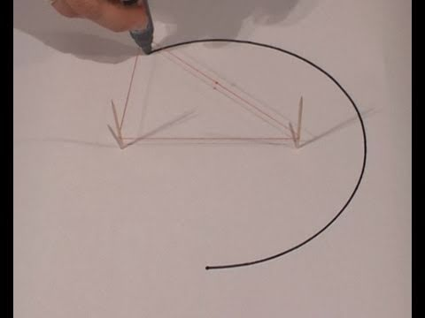
Drawing an Ellipse

Slide 2
Model / Steps (LAB PRACTICAL)
Place a blank piece of paper on cardboard.
Measure and place two push pins a distance apart.
Place string around push pins.
Put pencil inside the string with the push pins.
Extend the string out with the pencil and draw the ellipse.

Slide 3
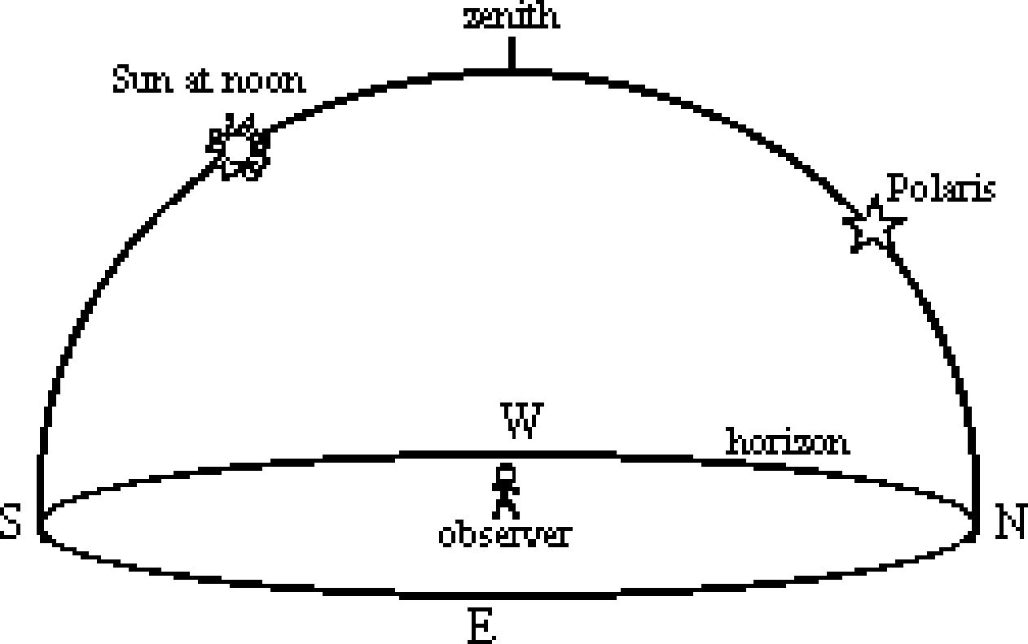
Astronomy Continued The Celestial Sphere:
A Model of the Sky

Slide 4
Horizon: Place where the Earth appears to meet the sky.
Zenith: Point in the sky directly above the observer.
OR the highest altitude that an object reaches.

Slide 5
How to locate an object in the sky.
Need 2 measurements:
Altitude: Angular distance above the horizon (max. is 90° and min. is 0°)
Azimuth: Angular distance around the horizon from the North.

Slide 6
Altitude and Azimuth

Slide 7
Polaris (The North Star)
Altitude of Polaris equals your latitude
(can only be seen in the northern hemisphere).

Slide 8
Polaris from New York State?

Slide 9
Constellation: Group of stars that form patterns.
They appear to move in arcs around Polaris due to Earth’s rotation.

Slide 10
**The apparent path of the Sun**
The Sun and stars rise in the East and set in the West.
Moves across the sky in an arc.
Length of Sun’s path determines length of day.
The Sun sets in the West.
June 21 is longest day of the year; December 21 is the shortest day.

Slide 11
Path of the Sun
At Noon, The Sun is always in our Southern sky (equator is south).

Slide 12
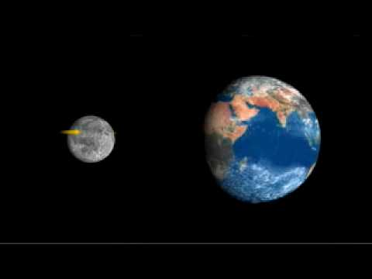
Video
Does the moon rotate video:

Slide 13
The Moon
REVOLUTION: orbits around Earth in ellipse.
Takes 27.3 days.
Perigee: Point at which moon is closest to Earth (appears larger).
Apogee (think Apart): Point at which moon is farthest from Earth.

Slide 14
The same side (half) of the Moon is always facing the Earth.

Slide 15
The Lunar Month:
Time it takes for 1 full moon cycle: 29.5 days.
This is longer than the time it takes the moon to revolve (27.3 days), because the Earth is also in orbit around the Sun, and the moon has to “catch up”.

Slide 16
Phases of the Moon:
Sun’s light reflects off the moon, so we can see a portion of it from Earth.

Slide 17
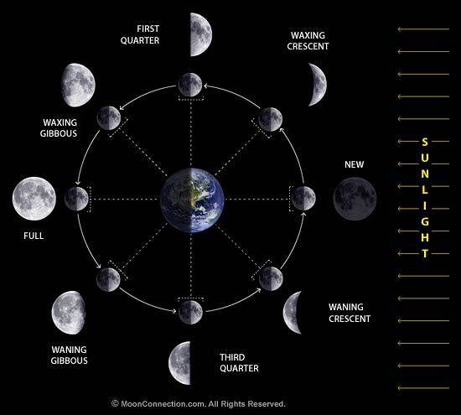

Slide 18
1 2 3 4 5 6 7 8
New Moon 5) Full Moon
Waxing Crescent 6) Waning Gibbous
1st Quarter 7) 3rd Quarter
Waxing Gibbous 8) Waning Crescent
Waxing: Lit part of moon increasing in size.
Waning: Lit part of moon getting littler

Slide 19
Phases of the Moon

Slide 20
Waxing or Waning?
“When the light is on the right, the moon is gaining in light”
Crescent: Sliver
Gibbous: 3/4

Slide 21
Waxing or Waning?

Slide 22
Waxing or Waning?

Slide 23
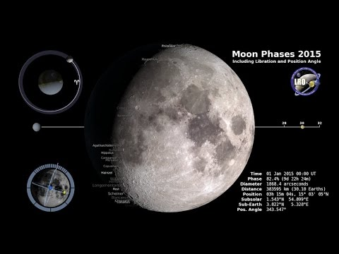
Video - Phases

Slide 24
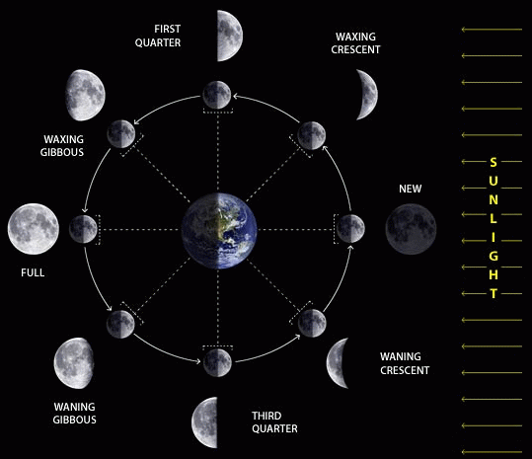
Moon Phases WRKST
Draw the moon half lit from the SUN!

Slide 25
Moon Phases WRKST
2. Draw what the moon would look like from Earth.

Slide 26
Exit Ticket: Waxing or Waning?

Slide 27
Eclipses
Don’t occur every month due to the plane of the moon’s orbit.
Lunar Eclipse: Moon moves into Earth’s shadow. About 1 per year.

Slide 28
Solar Eclipse
Moon’s small shadow hits Earth, blocks sun, very rare.

Slide 29
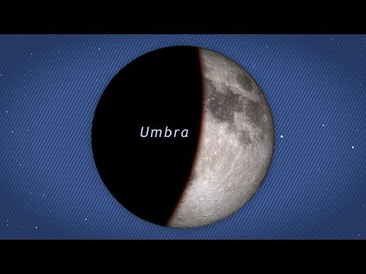
Video - Eclipses

Slide 30
Tides
The Moon’s gravity pulls on the Earth’s ocean waters, causing 2 high tides and 2 low tides each day.

Slide 31
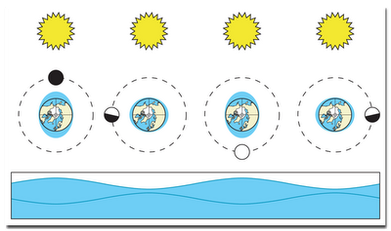
Tidal Cycles

Slide 32
Video

Slide 33
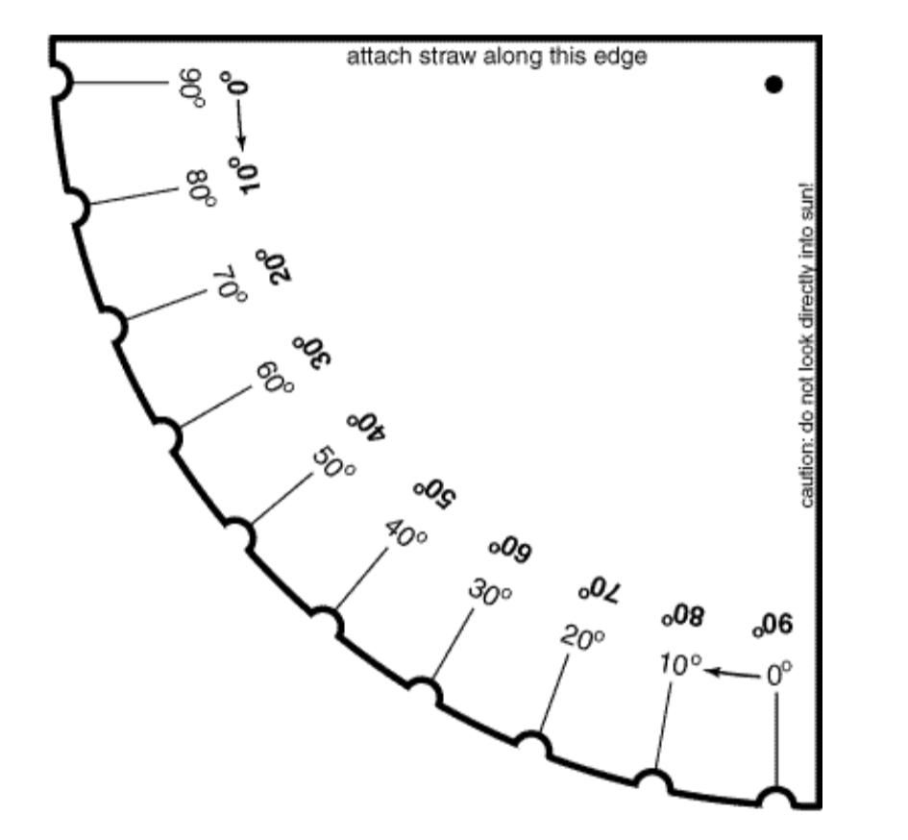
Astrolabe

