Slide 1
Erosion by Wind
Last Notes for the Erosion and Deposition Unit

Slide 2
Erosion by Wind
Found most often in: deserts and along beaches.
Sediment Size: based on wind velocity, usually sand.
Sediments become: frosted and pitted.

Slide 3
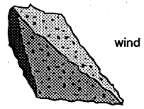
Pitted Sediment

Slide 4
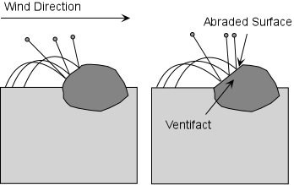
Wind: Flattens Surfaces

Slide 5
Erosional Features of Wind
Formations develop due to erosion.
Sediments are only carried 1-4 meters off the ground.
Can form caves, natural bridges, and mushroom rocks:
Erosion near ground level.

Slide 6
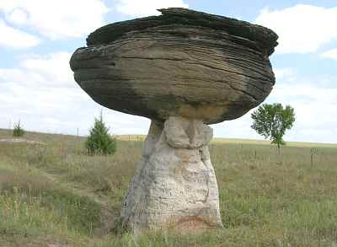
Mushroom Rock

Slide 7
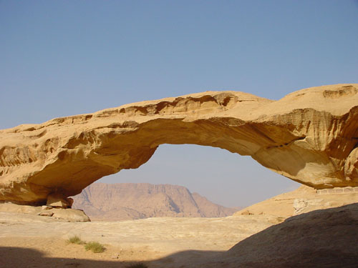
Natural Bridge

Slide 8
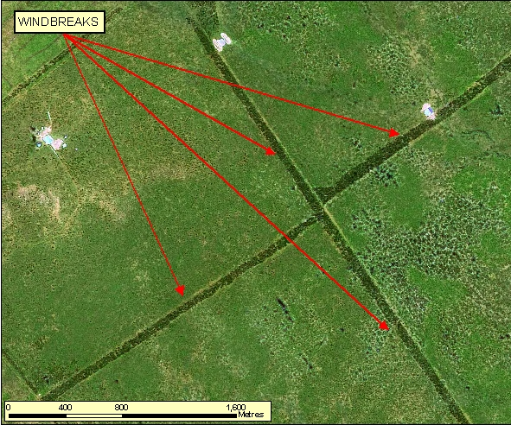
Windbreaks

Slide 9
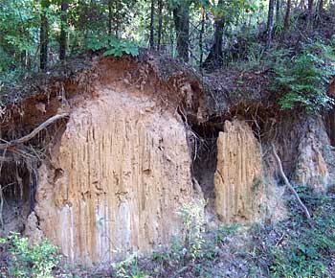
Depositional Features
Wind: Sorted Sediment
Loess: Fine silt deposit (very fertile).

Slide 10
Depositional Features
Sand Dunes: Hills of sand.
windward side: gentle slope.
leeward side: steep slope.

Slide 11
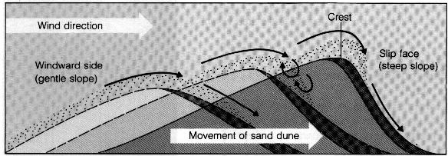
Sand Dune

Slide 12
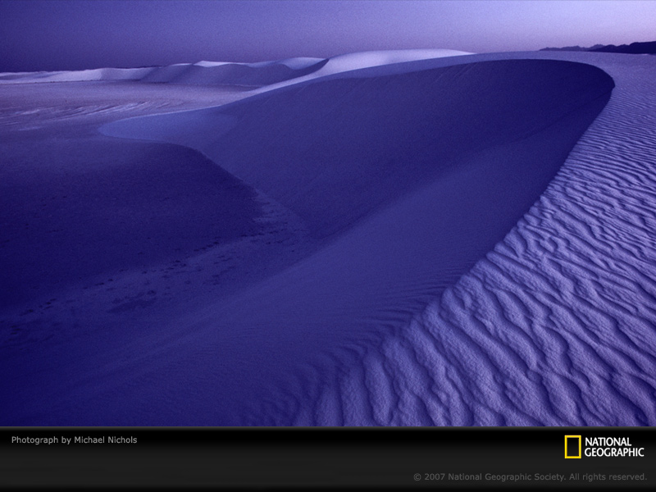
Which direction is the wind moving?

Slide 13
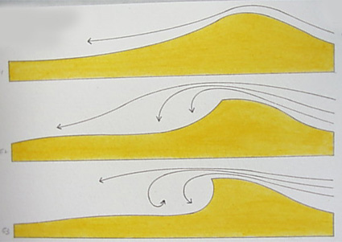
Formation of Sand Dune

