Slide 1
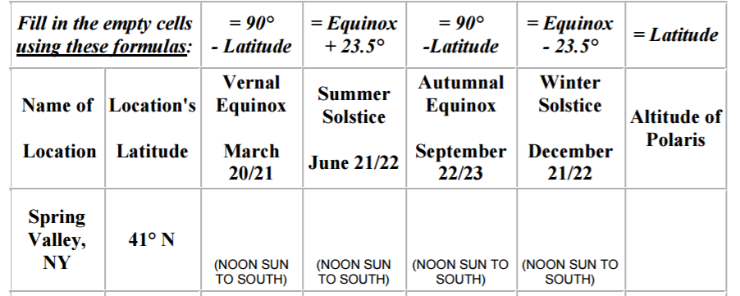
Sun’s Path Lab

Slide 2
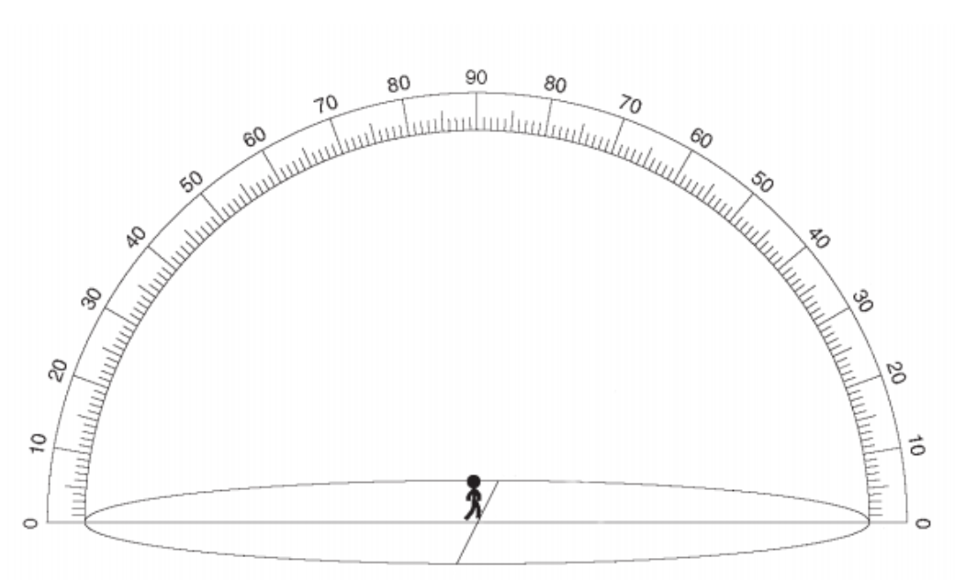
Sun’s Path Lab

Slide 3
Insolation: Incoming Solar Radiation (Continued)
Electromagnetic Energy and the Atmosphere

Slide 4
Effect of the Atmosphere

Slide 5
Insolation can be:
Absorbed (taken in): 15% by atmosphere
50% by Earth’s surface
Reflected (bounced back): 6% by atmosphere
4% by surface (depends on
type of surface)
25% by clouds
Scattered: bounced in several directions
Transmitted: passed through

Slide 6
Electromagnetic Energy and the atmosphere
Ultraviolet light is absorbed by the ozone in the upper atmosphere.
Most visible light is transmitted (passed).
Infrared (heat) radiation can be absorbed by water vapor and carbon dioxide.
Clouds reflect insolation and infrared radiation.
Aerosols (fine solids in the air): scatter insolation

Slide 7
Effects of the Earth’s surface on Insolation
Sunlight can be reflected or absorbed by Earth.
Color: Dark absorbs more than Light
Texture: Rough absorbs more than Smooth.
Luster: Dull absorbs more than Shiny

Slide 8
Terrestrial Radiation
As the Earth is heated (absorbs energy), it re-radiates infrared radiation.
Ice and snow reflect sunlight (stays cold).
Cities are hotter than rural areas. Mainly because of blacktop (roads/parking lots) and roofs.
Cities also have less vegetation.

Slide 9
Hot Asphalt

Slide 10
Cities are hot

Slide 11
Land heats up and cools off faster than water
3 Reasons:
1) Specific Heat: Water requires the most energy to heat it.
2) Transparency: Light travels into water.
3) Convection currents: Water mixes with the deep, cold water.

Slide 12
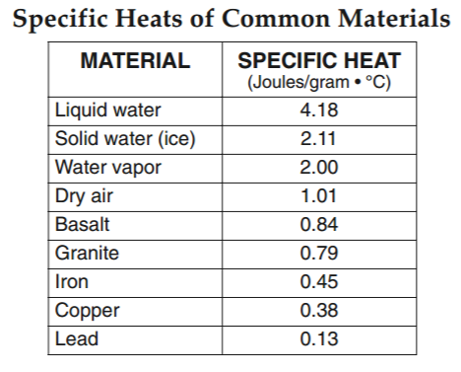
Specific Heat - Pg 1
4.18 Joules to heat up 1 gram of water 1 degree celsius.
MULTIPLY

Slide 13
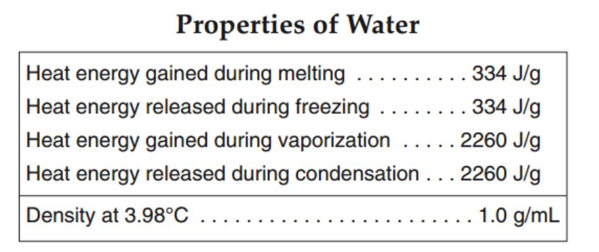
Properties of Water - Pg 1
334 Joules of energy gained during melting of 1 gram of ice.
MULTIPLY

Slide 14
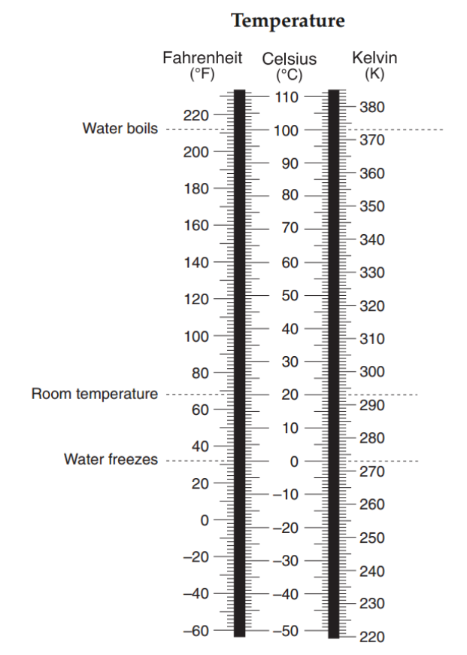
Temperature - Pg 13
0 degrees Celsius is equal to 32 degrees Fahrenheit and is equal to 273 degrees Kelvin.

Slide 15
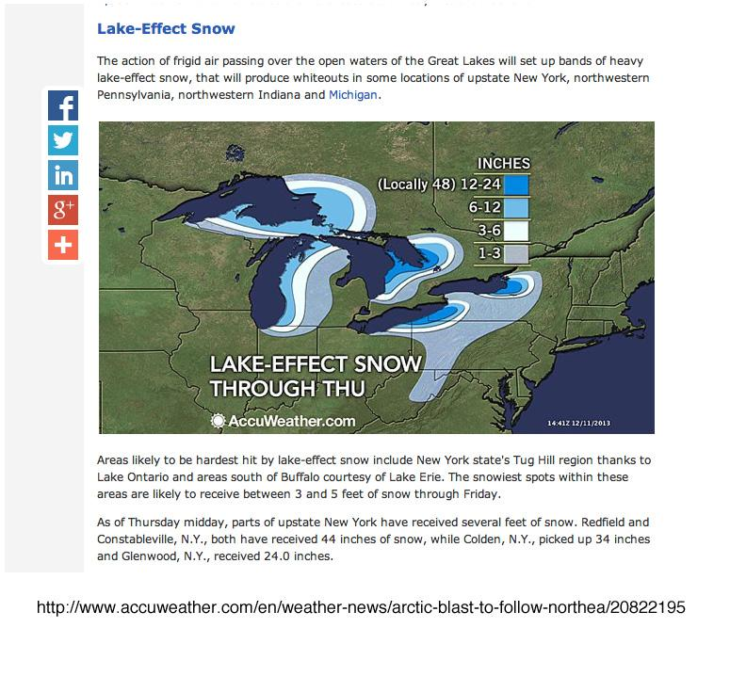

Slide 16
Effects of Insolation on Temperature
High angle of insolation = high temperature
As the duration of insolation increases, temperature increases (as the days get longer)

Slide 17
During the Year
Maximum Insolation: June 21st
Maximum Temp: Mid-Late July
Temperature Lag: The Sun heats up the Earth before Earth can radiate heat back.
Minimum Insolation: Dec. 21st
Minimum Temperature: Mid-Late Jan.

Slide 18
During the Day
Maximum Insolation: Solar Noon
Maximum Temperature: Mid-afternoon
Minimum Temperature: Just after sunrise

Slide 19
Greenhouse Effect
The Earth’s atmosphere acts like a greenhouse, trapping infrared (heat) energy.

Slide 20
Greenhouse
1. Incoming visible light (short wavelength) passes through the glass
2. Soil absorbs visible light and then re-radiates infrared radiation
3. Infrared radiation (long wavelength) can not pass through the glass

Slide 21
Earth’s Atmosphere
1. Insolation-visible light (short wavelength) passes through the atmosphere
2. Earth's surface absorbs visible light and then re-radiates Infrared radiation
3. Infrared radiation (long wavelength) is absorbed by greenhouse gases in the atmosphere

Slide 24
Greenhouse Gases
Water vapor
Carbon dioxide (emitted whenever fossil fuels are burned)
Methane
Global Warming: The average temperature of Earth is rising due to increasing levels of carbon dioxide.

Slide 25
Earth’s Climate Changes

Slide 26
But CO₂ is increasing faster than ever before.

Slide 27
Avg. Temps Increasing Quickly

Slide 28
Specific Heat - Pg 1
4.18 Joules to heat up 1 gram of water 1 degree celsius.
MULTIPLY

Slide 29
Properties of Water - Pg 1
334 Joules of energy gained during melting of 1 gram of ice.
MULTIPLY

Slide 30
Temperature - Pg 13
0 degrees Celsius is equal to 32 degrees Fahrenheit and is equal to 273 degrees Kelvin.

Slide 31
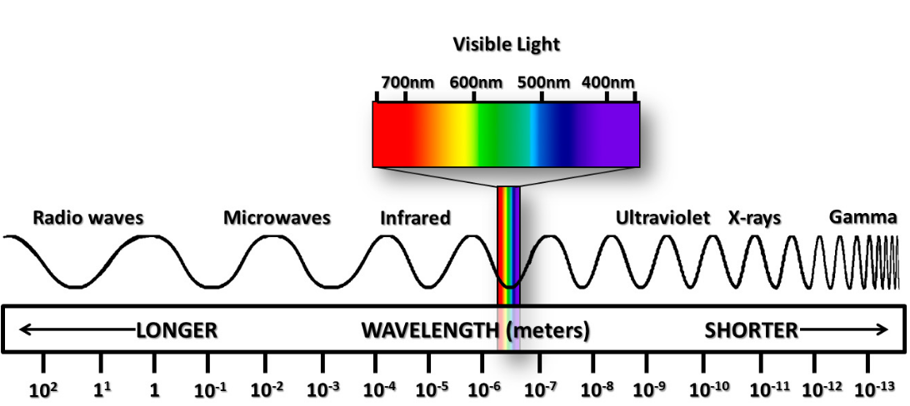
Answer Questions
Answer the questions

Slide 32
Turn and Talk
What can humans do to try and stop climate change?
What can humans do if the Earth is not livable anymore?

