Slide 1
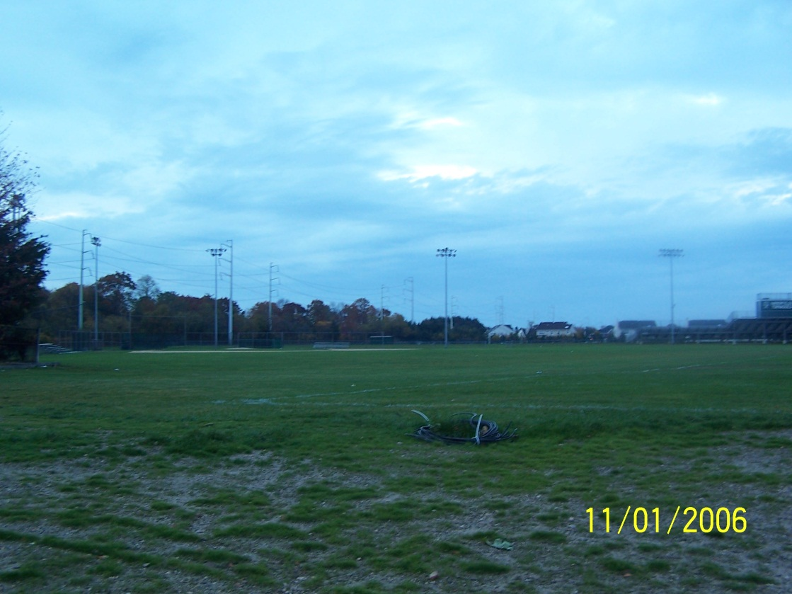
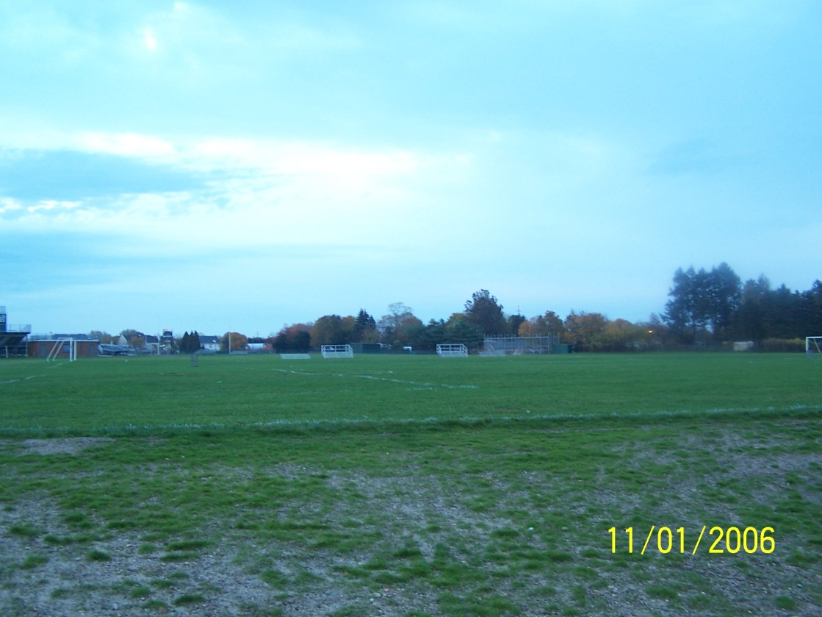
The changing location of sunrise as seen from the fields of HHS
The fields viewed from the corner of the tennis courts

Slide 2
The path of the sun changes with the seasons.

Slide 4
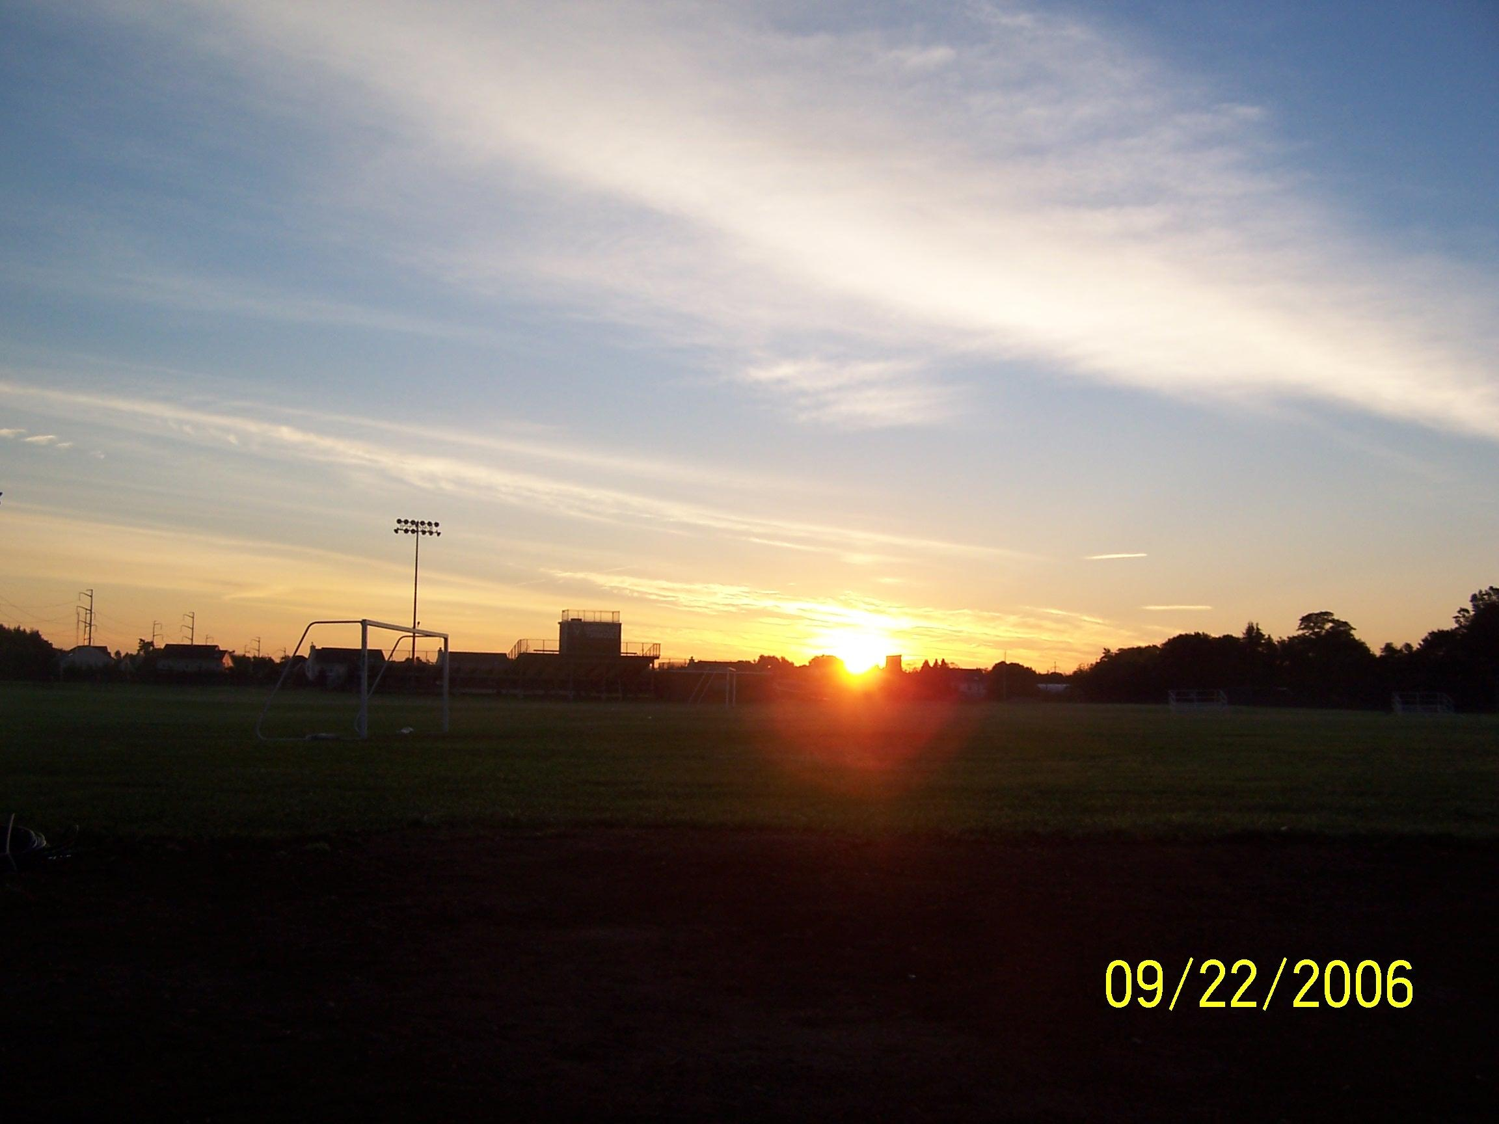
5:40 AM
This was a special day. Do you know what this day was?
The Fall or Autumn Equinox!

Slide 5
5:40 AM
Sunrise is perfectly due East on this day!
Draw the directionals and mark the location and time of sunrise on your answer sheet.
E
N
S
W

Slide 6
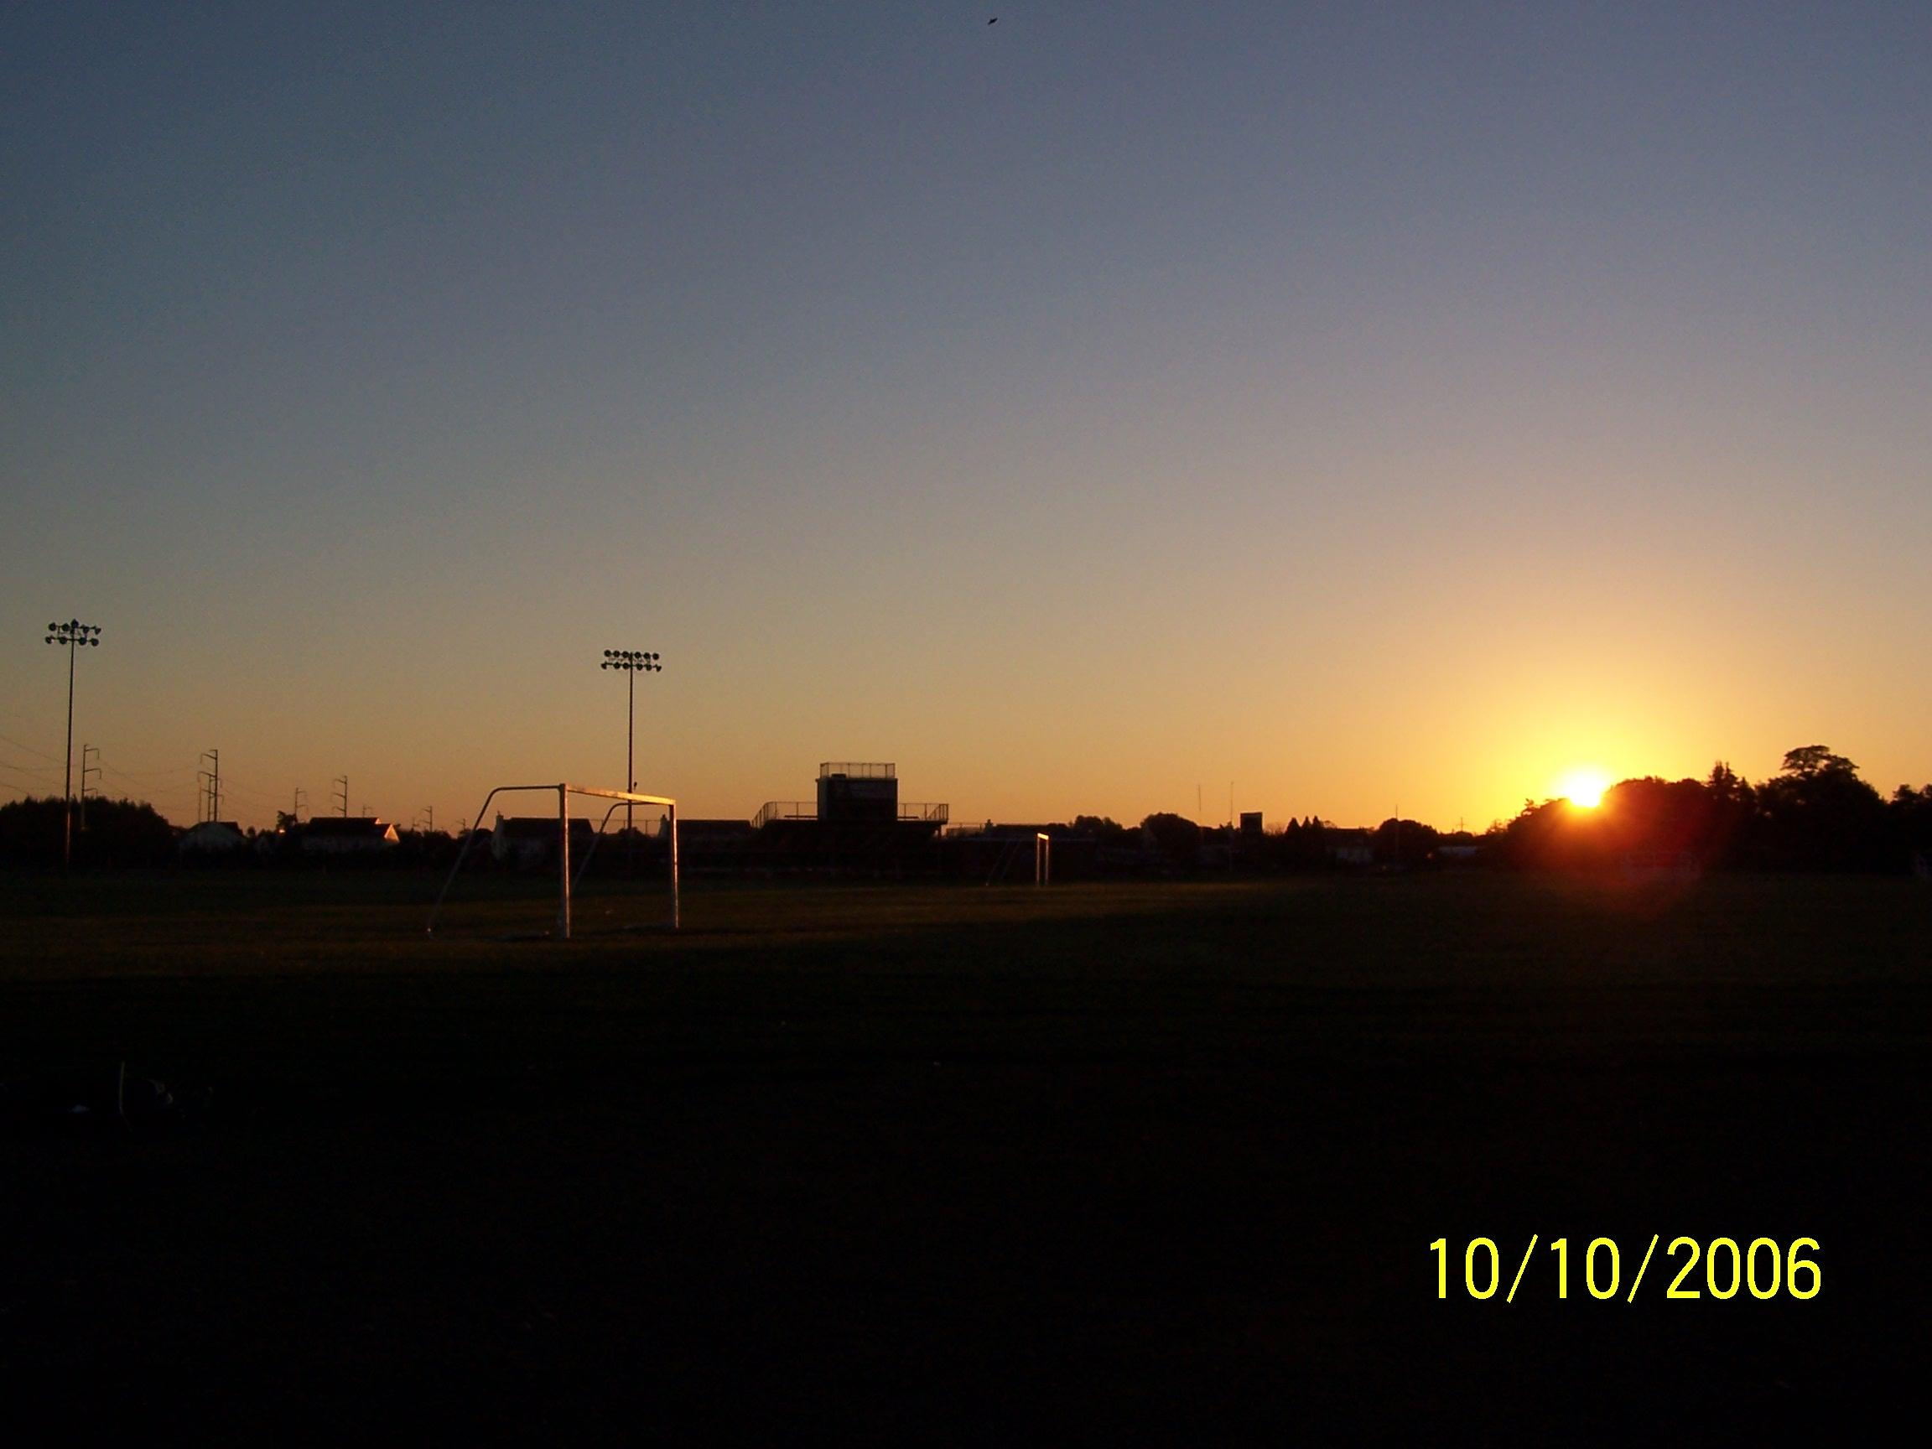
5:59AM
What happened to the direction of sunrise?
DUE
EAST
E
N
S
W

Slide 7
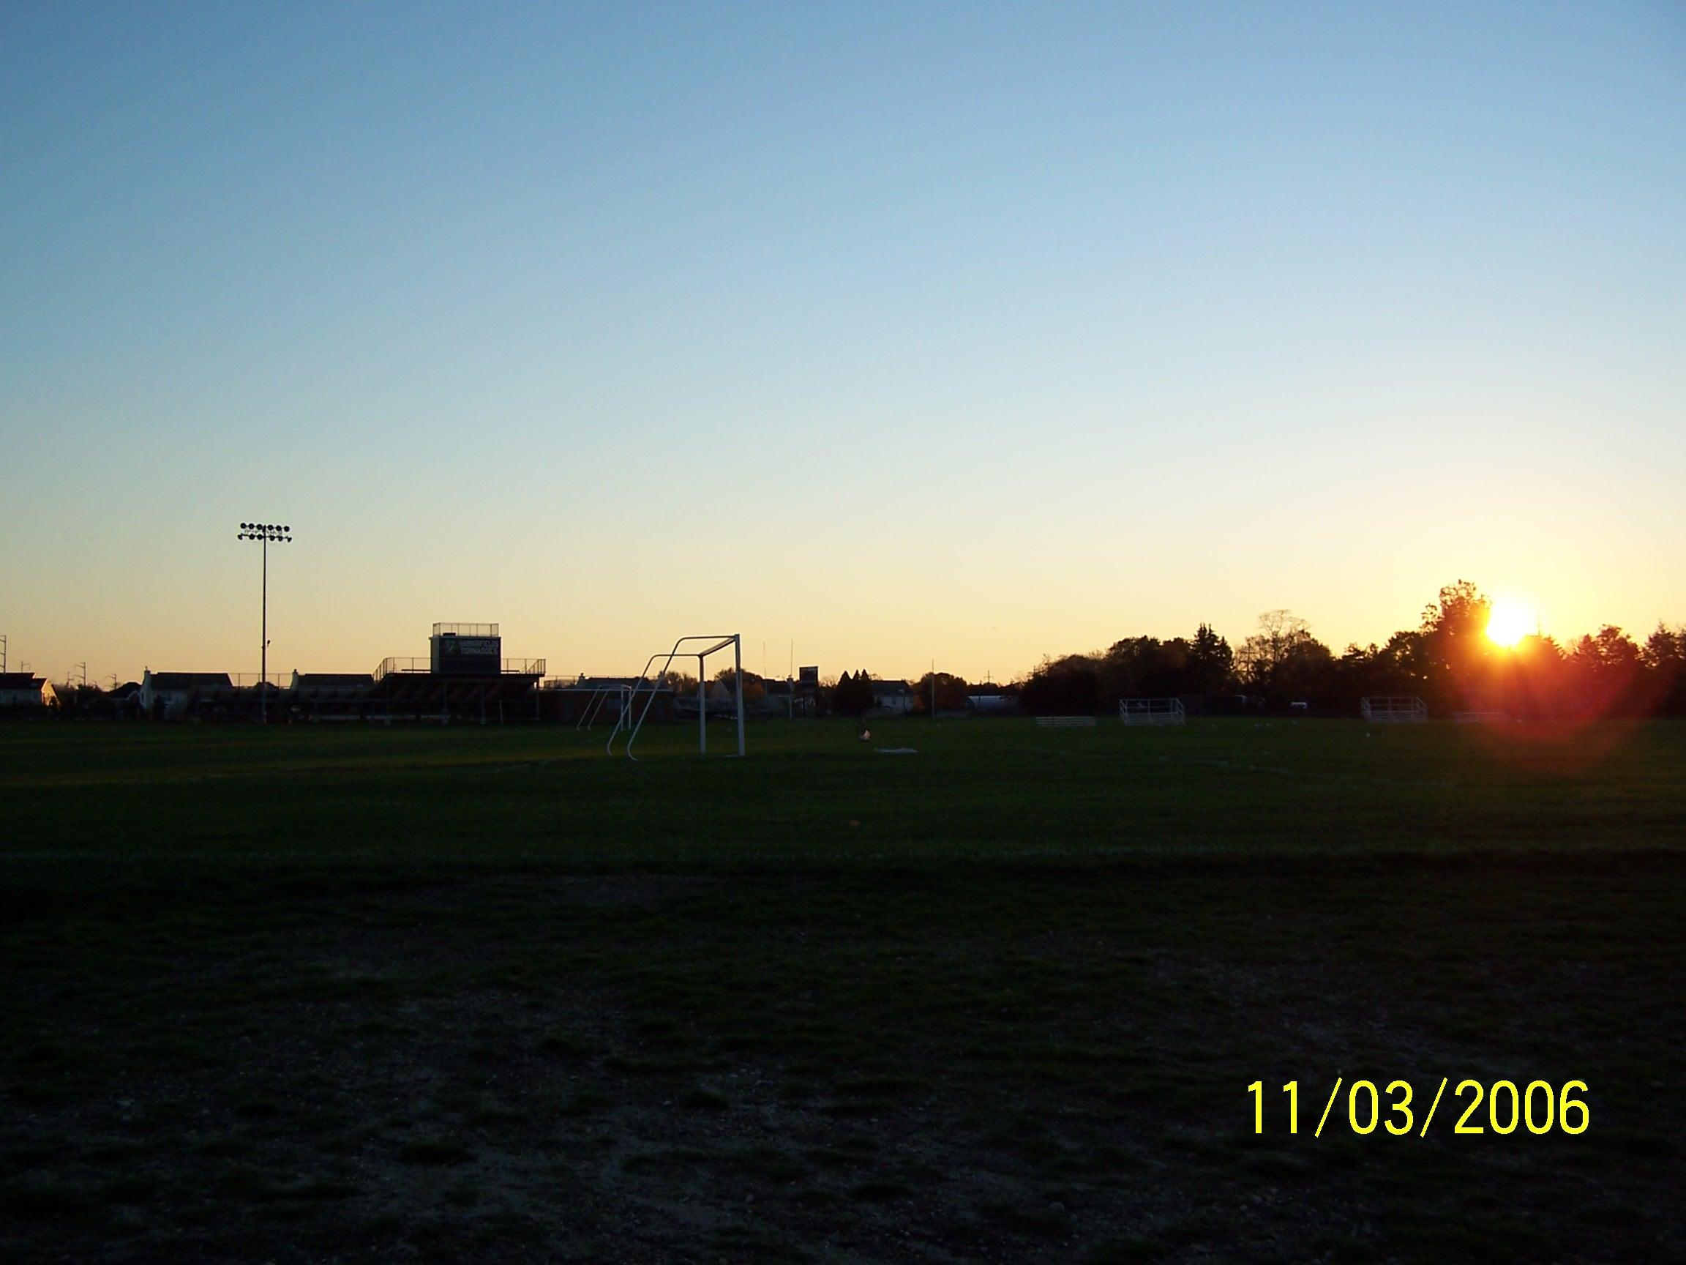
6:26 Am
DUE
EAST
E
N
S
W

Slide 8
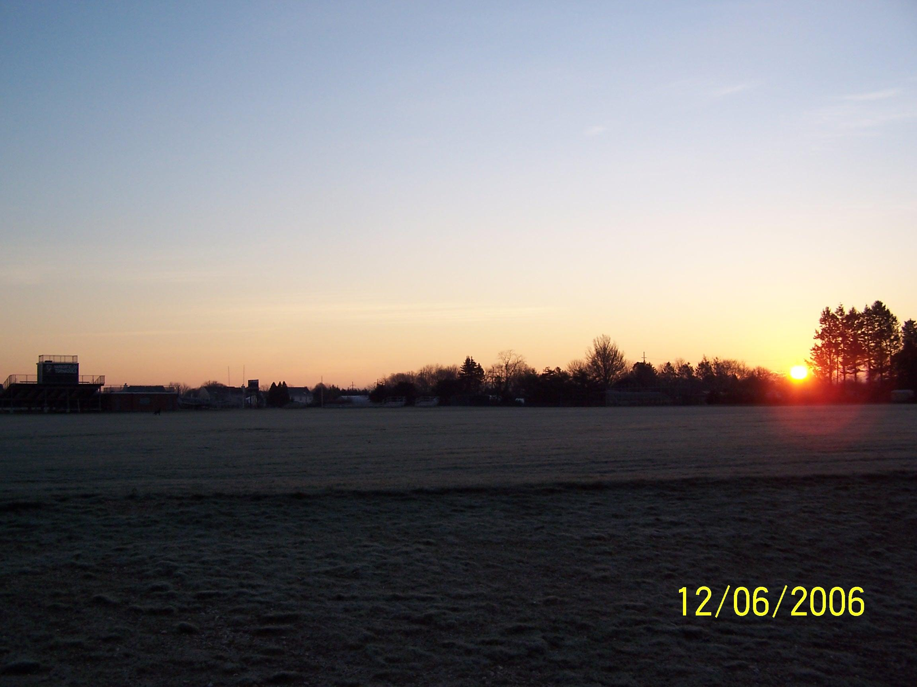
Sunrise 7:03AM
DUE
EAST
E
N
S
W

Slide 9
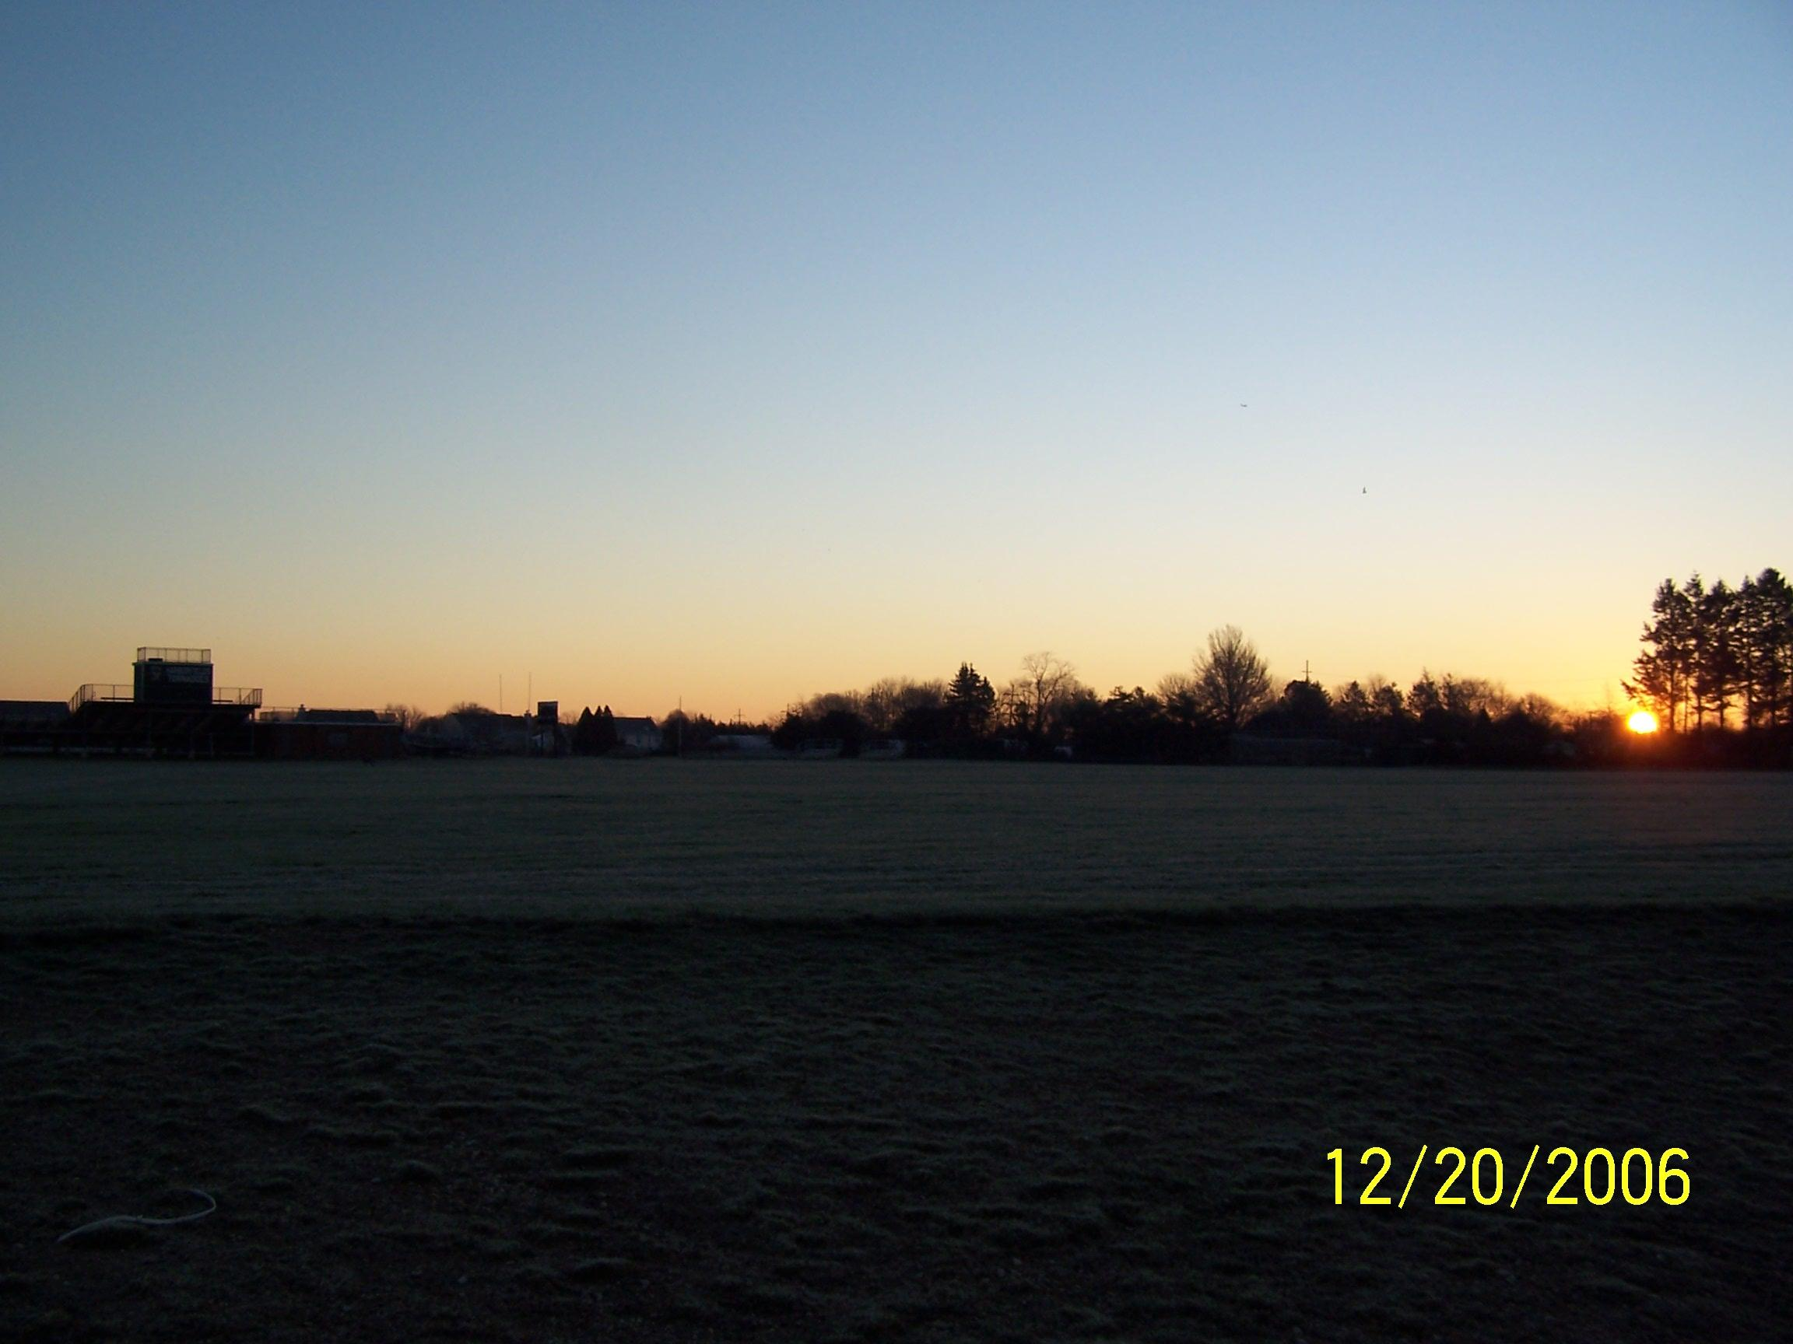
7:19 AM
The winter solstice was 12/21. Notice how the sun has been slowing down. Traveling less and less each month. The word Solstice literally translates to “Sun stops”
This marks the farthest south the sun will travel.
DUE
EAST
E
N
S
W

Slide 10
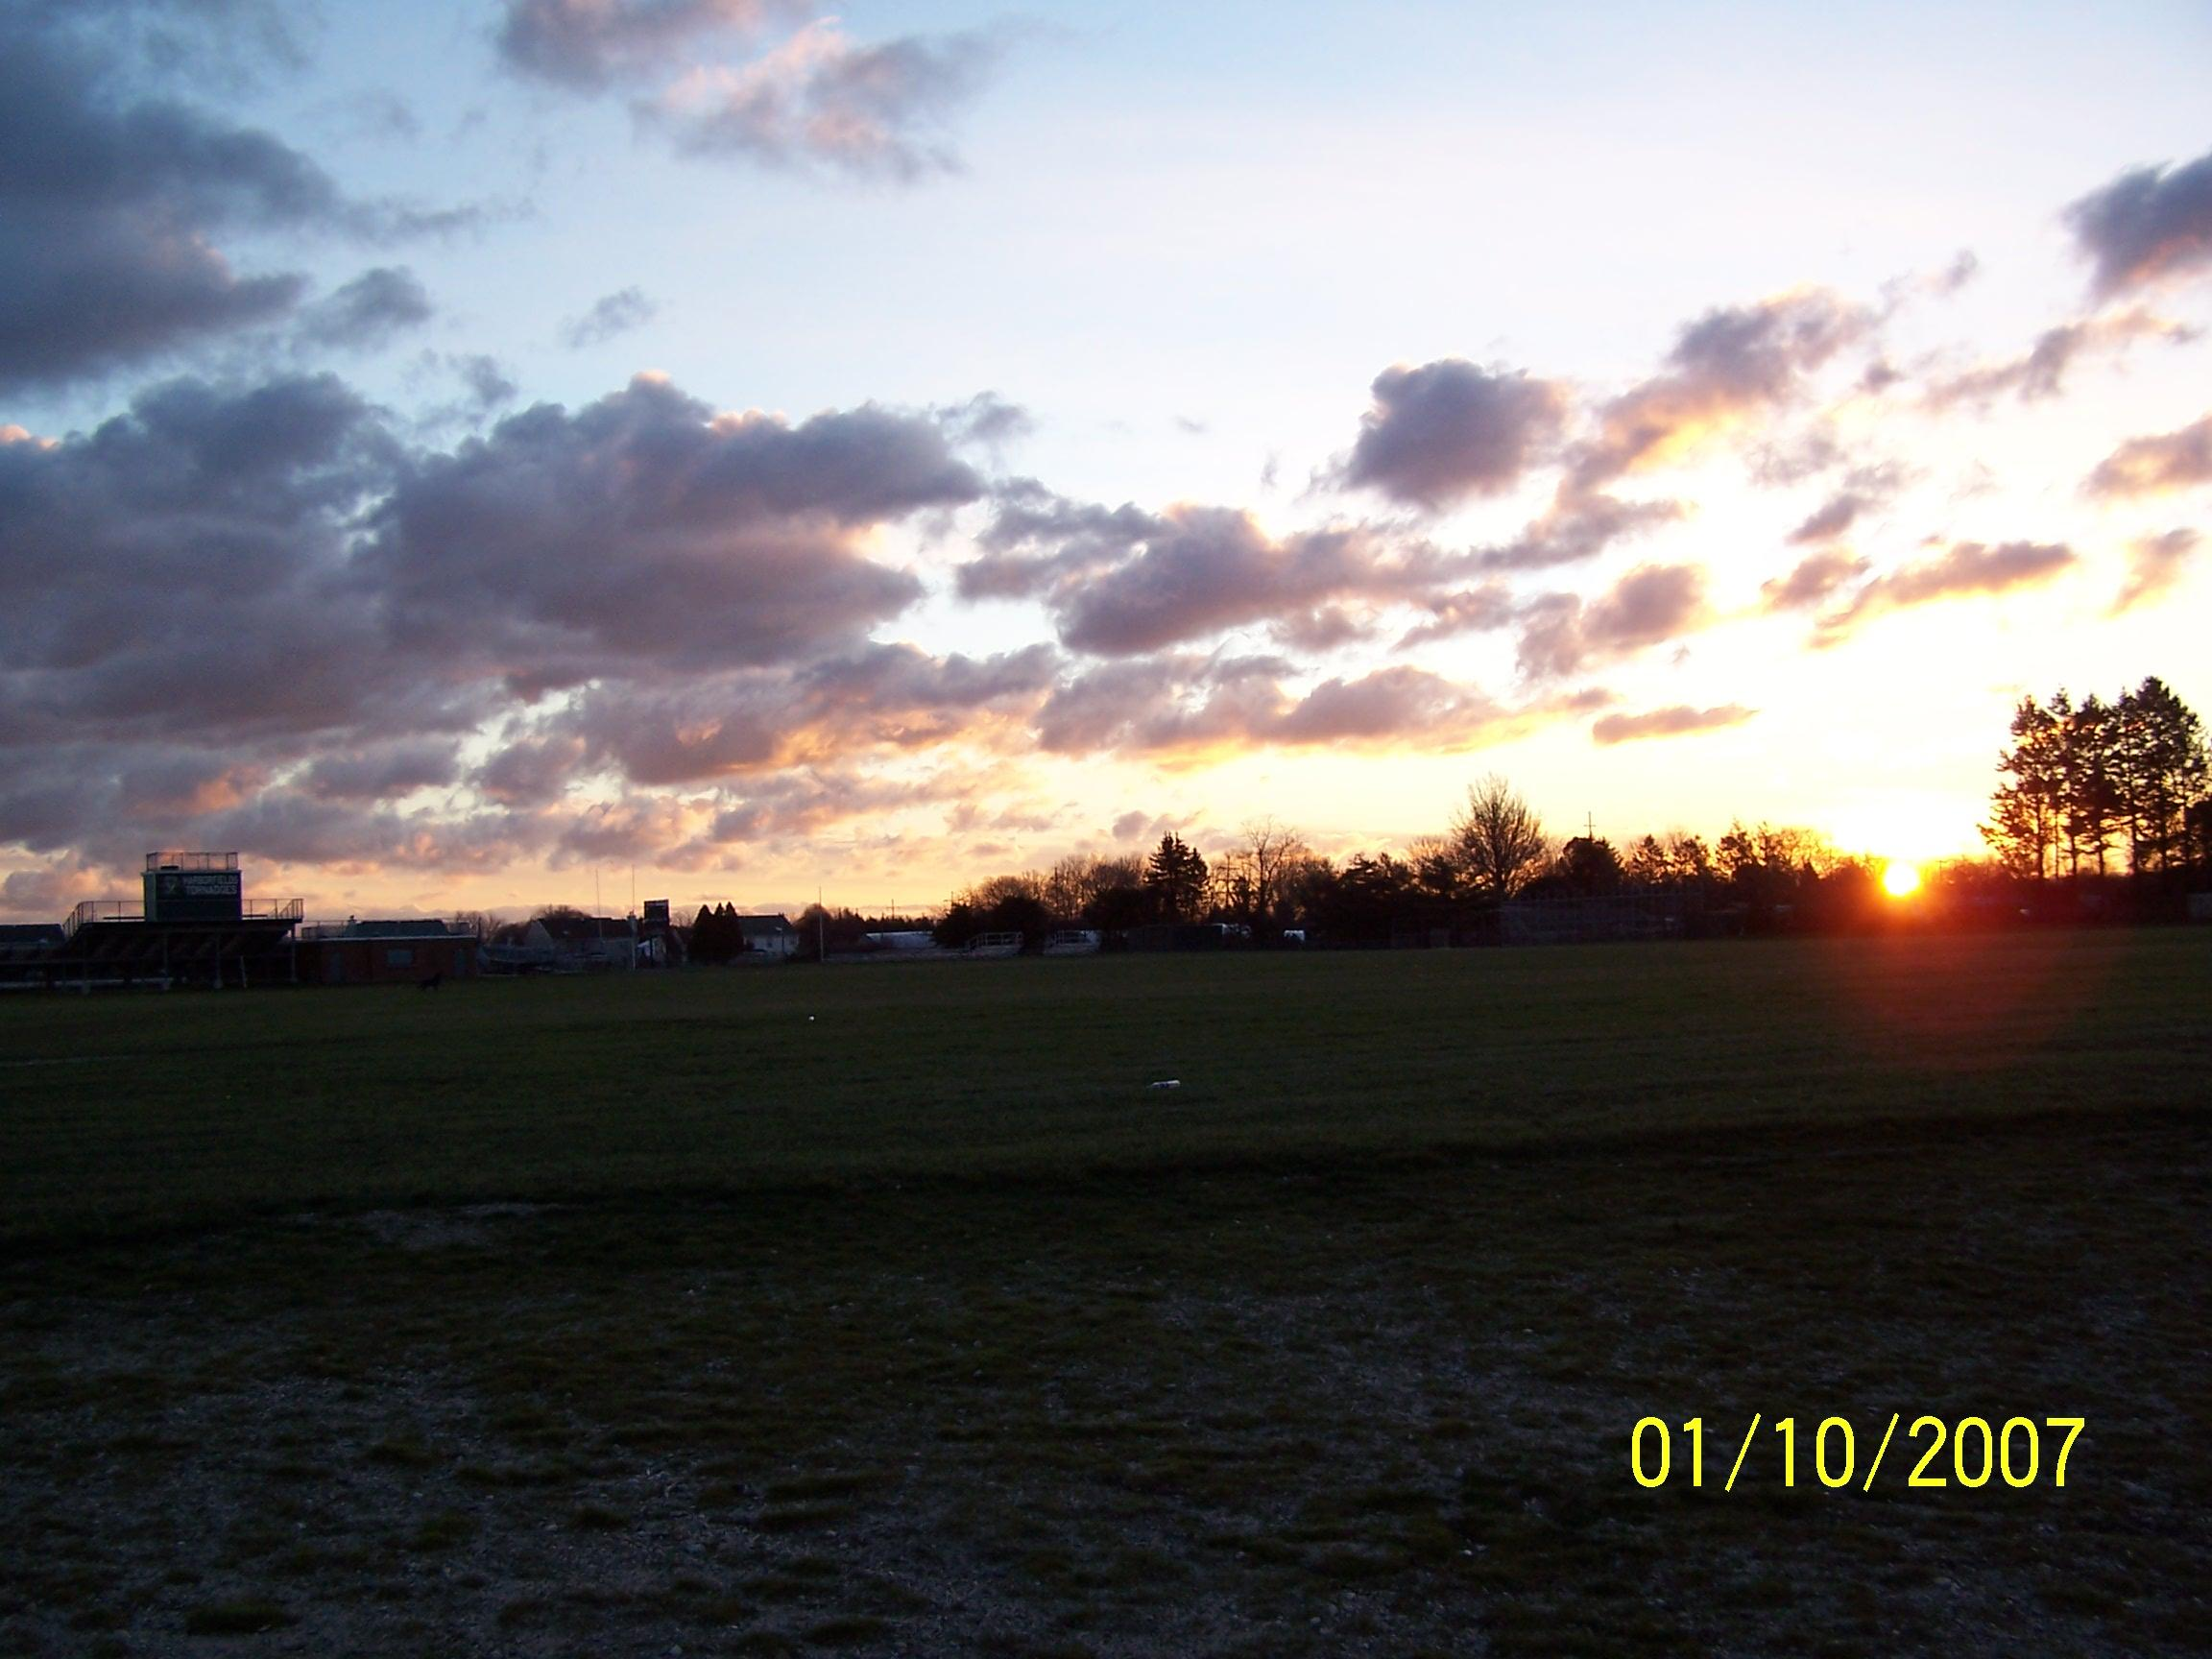
7:15AM
What happened to the direction of sunrise?
DUE
EAST
E
N
S
W

Slide 11
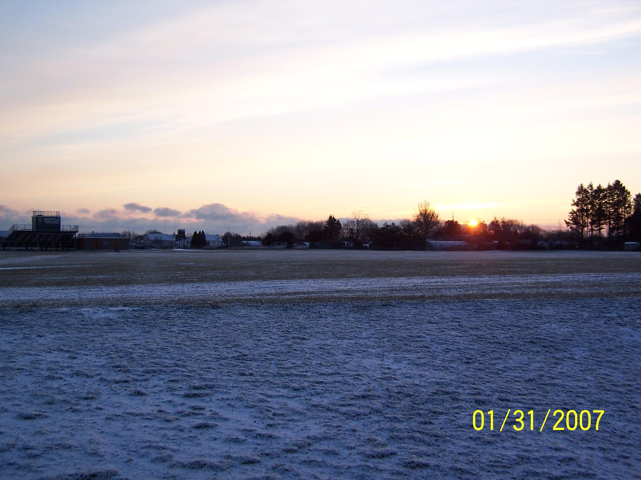
Sunrise 7:05 AM
What’s happening to the time of sunrise?
DUE
EAST
E
N
S
W

Slide 12
Sunrise 6:29AM
E
N
S
W

Slide 13
Sunrise 5:55 AM (although my watch read 6:55 thanks to daylight savings)
E
N
S
W

Slide 14
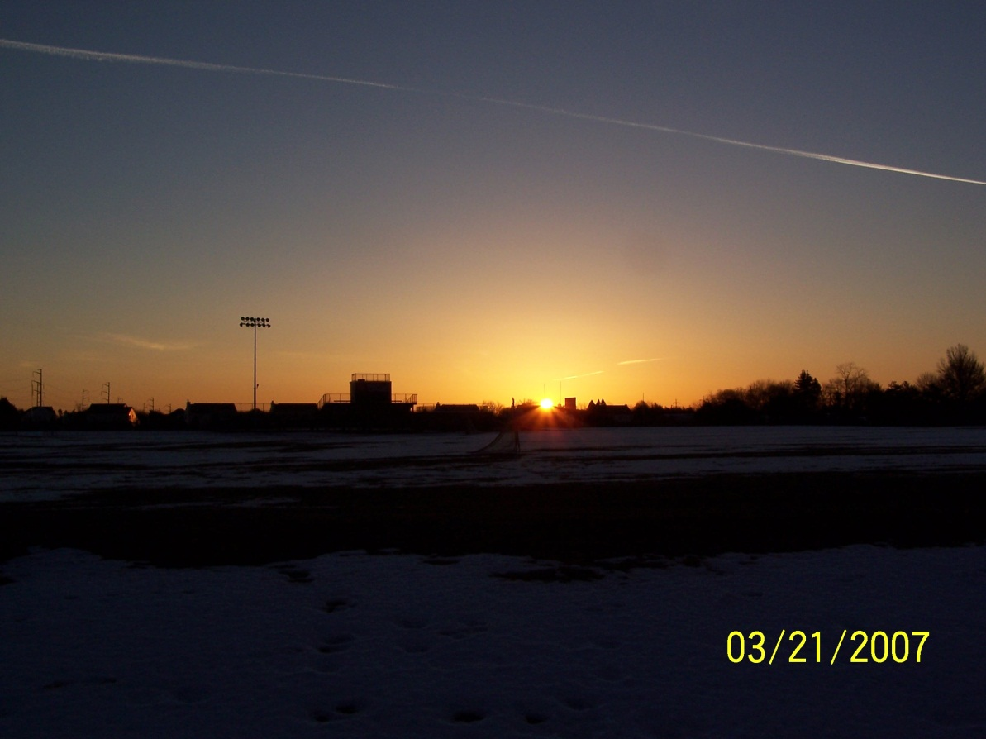
Recall the Fall Equinox
Here is the Spring Equinox

Slide 15
What are some of the special circumstances about an equinox?
Make a prediction for where the location of sunrise will be as the spring season goes on?

Slide 16
Sunrise 5:15AM (6:15 because of daylight savings)
E
N
S
W

Slide 18
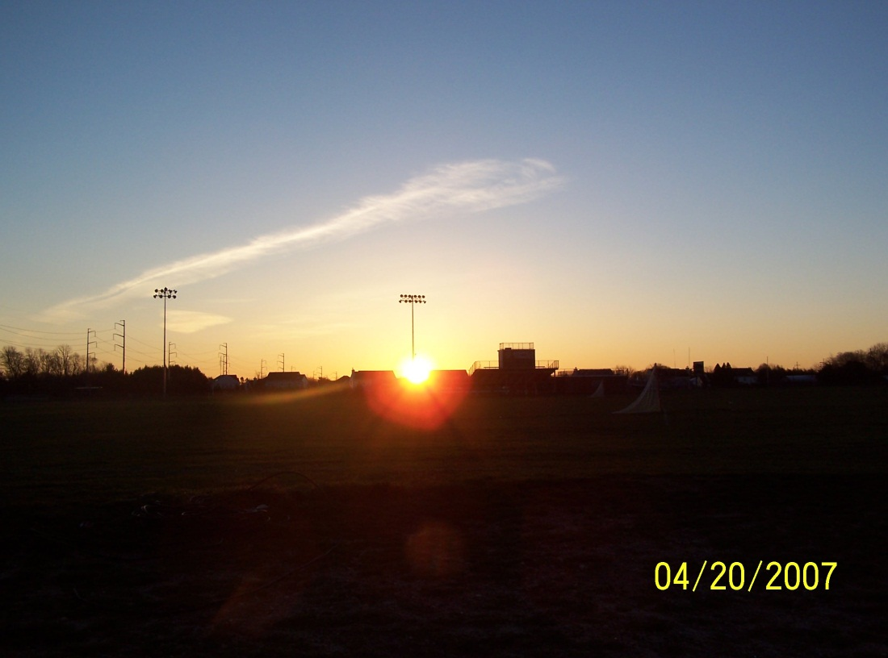
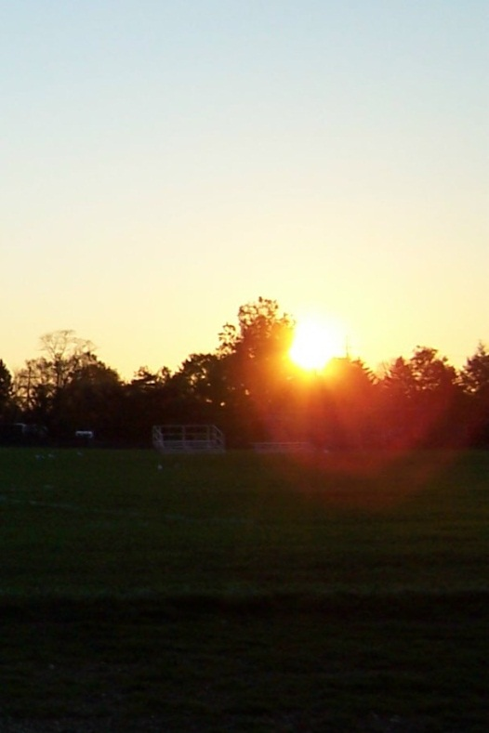
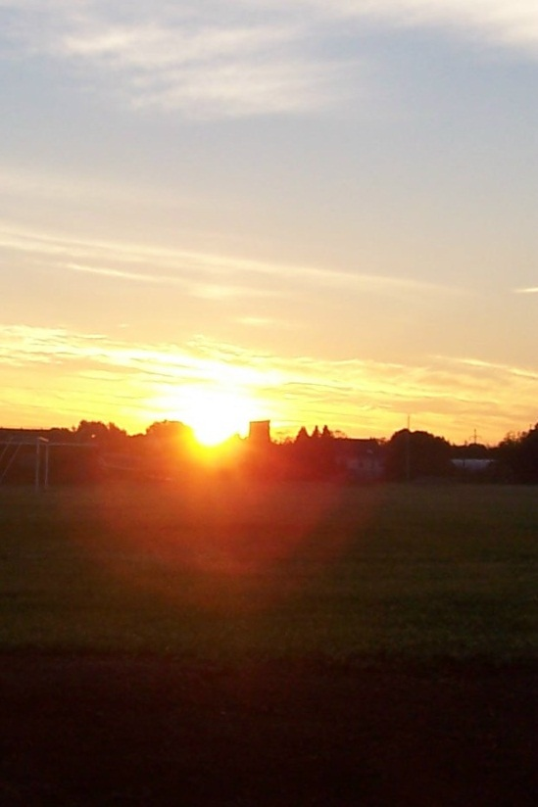
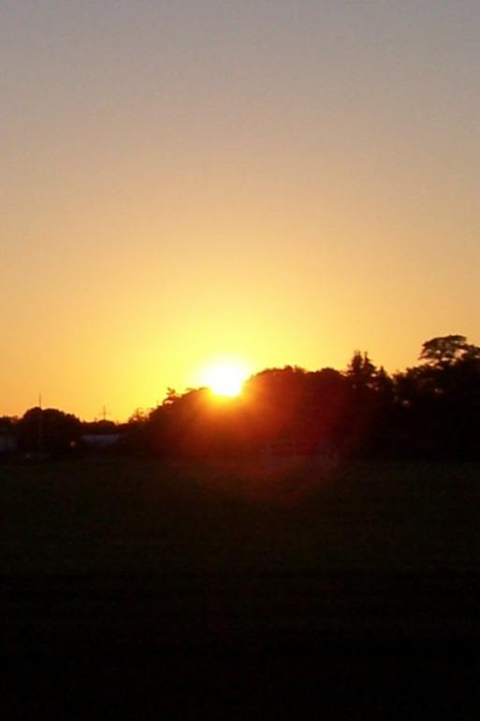
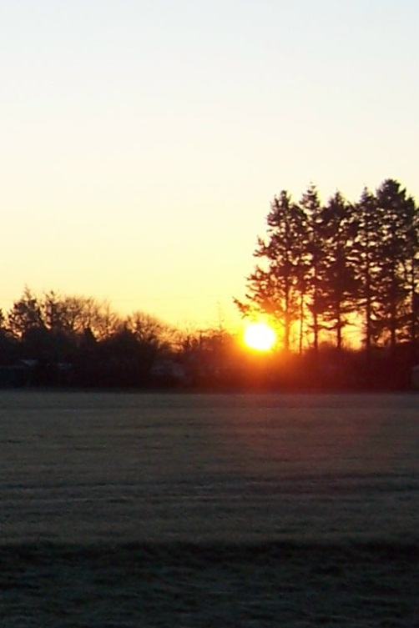
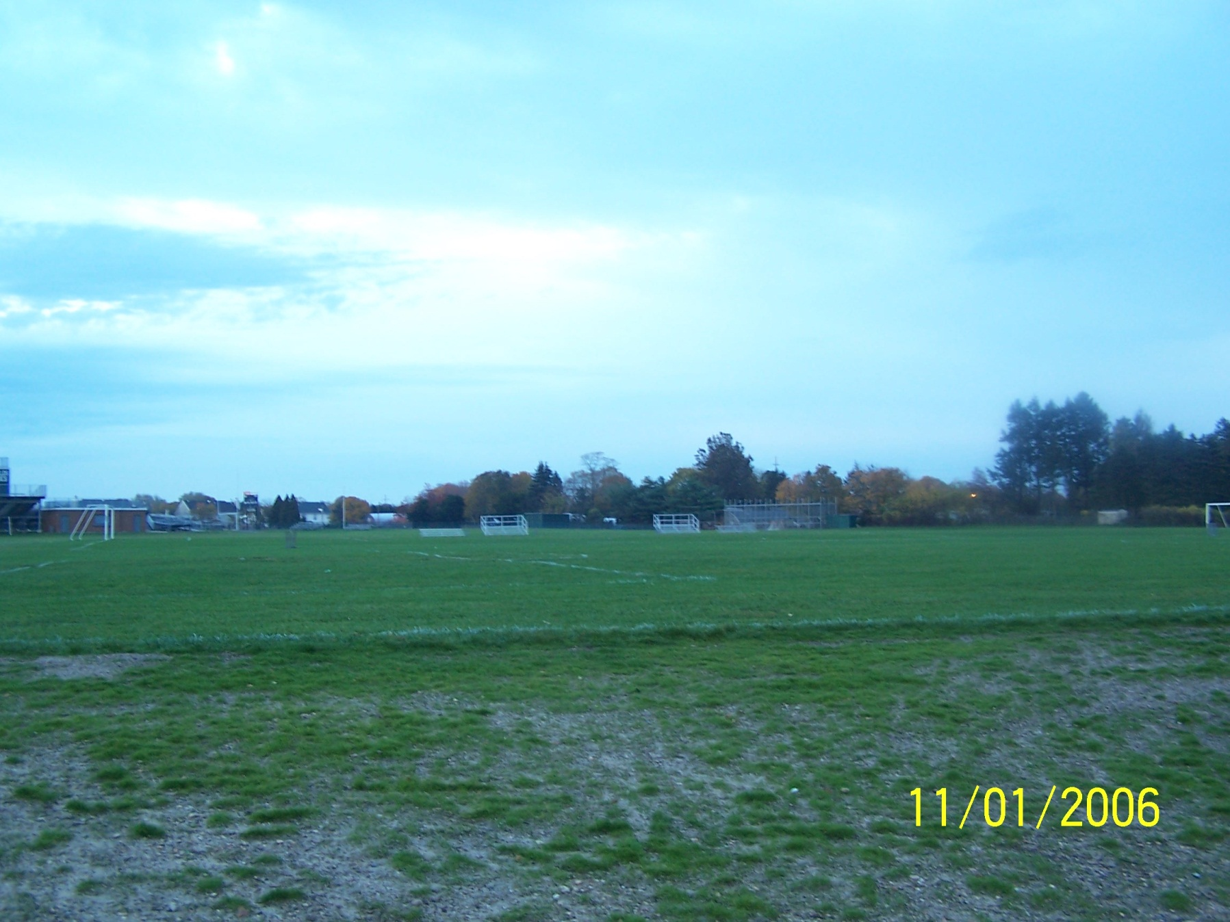

Slide 19
23½º swing each season!
Photo(s) taken by Anthony Ayiomamitis in Athens, Greece.

Slide 20
The path of the sun changes with the seasons.

Slide 21
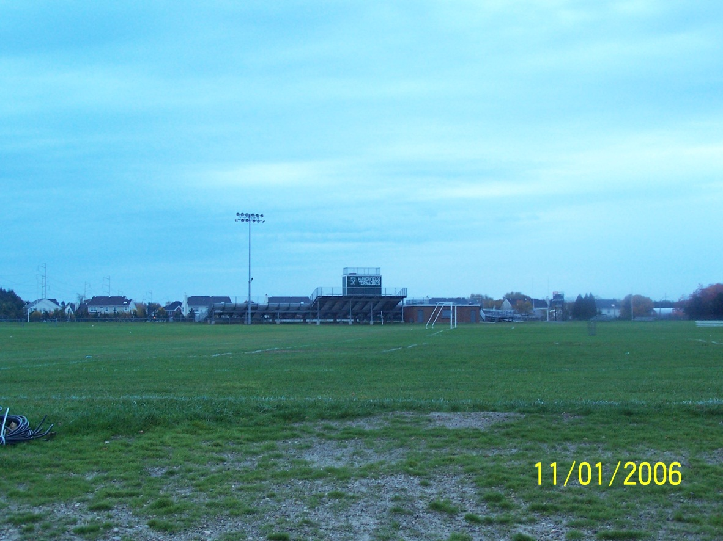
For September through December mark the location of sunrise with an arrow above the image (in the sky). Label each arrow with the date and the time of sunrise.
NAME:
For January through June mark the location of sunrise with an arrow below the image (on the grass). Label each arrow with the date and the time of sunrise.

