Slide 1
Insolation: IN SOL ATION
INcoming SOLar radiATION
Definition: Sun’s rays that reach the Earth.

Slide 2
Intensity of Insolation
Strength of solar radiation received by Earth.
Remember: Anything with temperature radiates energy.
The sun has A LOT of temperature, so it radiates A LOT of Energy.

Slide 3
Electromagnetic Spectrum:
High Intensity Low Intensity
(stronger energy) (weaker energy)
All you really need to know is that Electromagnetic Energy is just a fancy word for “energy that travels in waves”

Slide 4
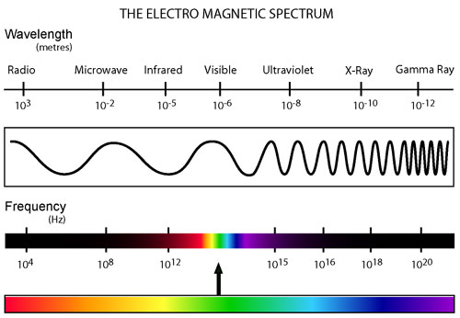
Electromagnetic: Energy that travels in waves.

Slide 5
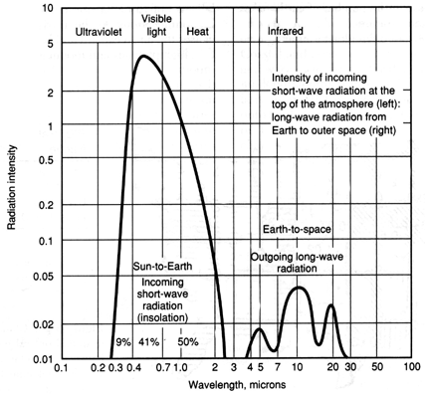
The sun emits: UV, light, heat

Slide 6
Factors affecting insolation
Angle of insolation:
Angle at which the Sun’s rays strike the Earth.
Greatest Angle = 90˚ Least = 0˚

Slide 7
As the angle of insolation increases, temperature increases.

Slide 8
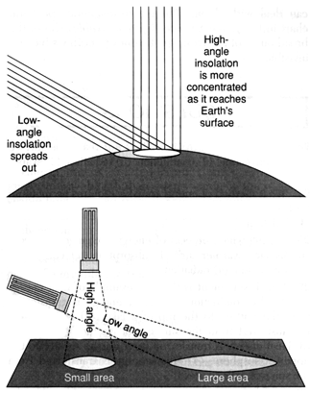
Factors affecting angle of insolation
Earth’s curved surface: Insolation is received unevenly.
Latitude: As latitude increases, angle of insolation decreases

Slide 9
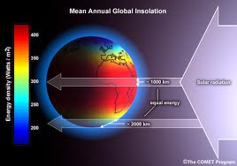
Temperature and Latitude

Slide 11
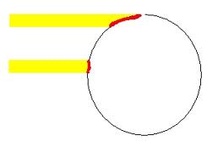
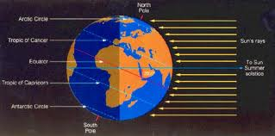
Earth’s curved surface:

Slide 12
Tropic of Cancer = 23.5°N Tropic of Capricorn = 23.5°S

Slide 13
When/where the noon sun can be seen directly overhead (at zenith)
Date | Latitude
March 21 | Equator 0°
June 21 | Tropic of Cancer 23.5°N
September 22 | Equator 0°
December 21 | Tropic of Capricorn 23.5°S

Slide 14
Seasons
Caused by Earth’s tilt and revolution.
The Earth is tilted at an angle of 23.5°.
In the N.H., insolation is greatest on June 21.

Slide 15
Tilting of Earth on its axis

Slide 16
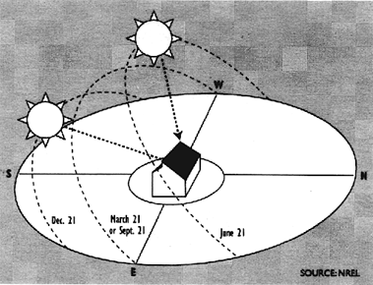
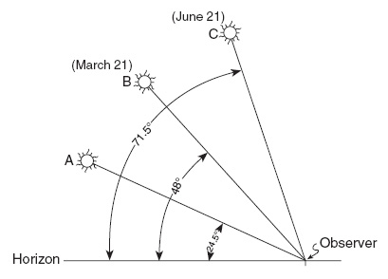
Time of Day
Greatest angle of insolation is at solar noon.

Slide 17
Duration of insolation
The length of time daylight is received.
Greatest in the summer when the days are longer.

Slide 18
Turn and Talk
What is insolation?
What are the factors that affect insolation?

Slide 19
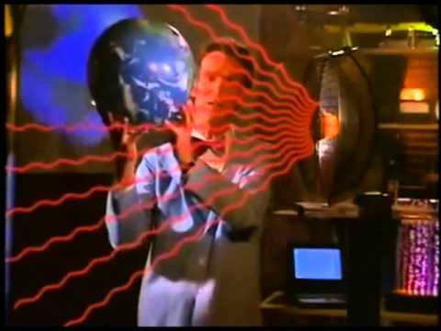
Bill Nye - Seasons

Slide 20
DIN:
Fill in this chart of when the sun will be directly overhead at solar noon.
Date | Latitude
March 21
 | Tropic of Cancer 23.5°N
September 22
December 21

Slide 21
Bill Nye - Seasons

Slide 22
Turn and Talk
Why are there seasons?
Why is the equator hotter than the poles?

Slide 23
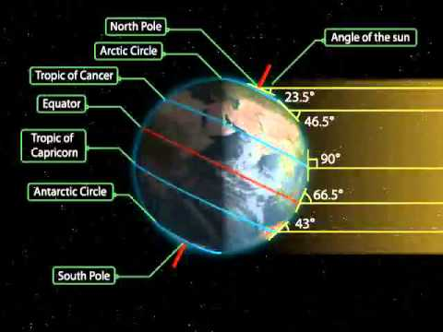

Slide 24
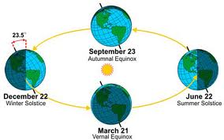
Animation
http://astro.unl.edu/naap/motion1/animations/seasons_ecliptic.html

Slide 25
Motion of the Sun Simulator
http://astro.unl.edu/naap/motion3/animations/sunmotions.html

Slide 26
Sun’s Path in NYS Video

Slide 27
Turn and Talk
Why is the sun’s look different throughout the year?
When is the sun the highest in the sky for us?
When is the sun the lowest in the sky for us?
What would the shadows look like on those days?

Slide 28
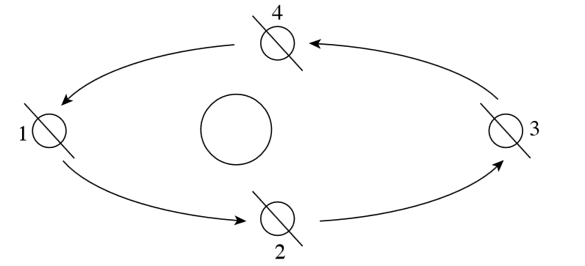
Practice

Slide 29
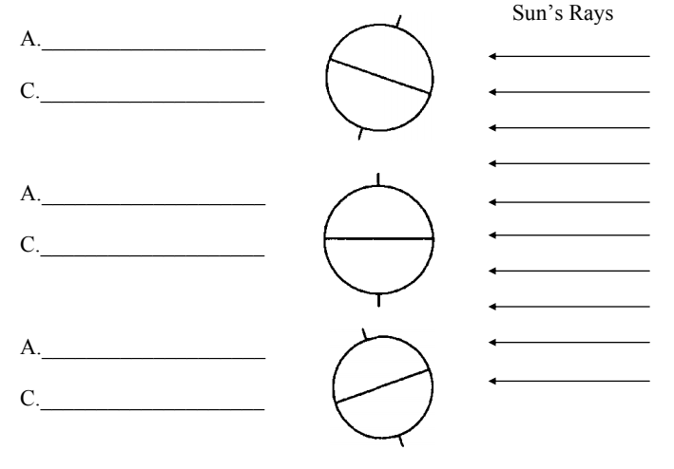
Practice

Slide 30
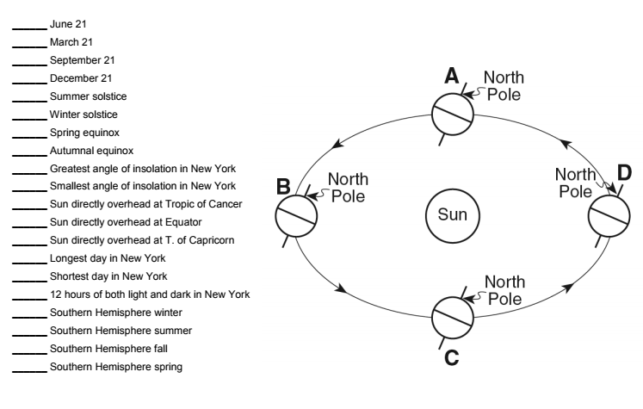
Practice

Slide 31
Turn and Talk (Round Table)
Question 1: If Earth's axis were not tilted at all, in other words, if it were perpendicular to Earth's plane of orbit, what effects would that have on people living in the United States? Be sure to mention any seasonal changes. Notice the Winter and Summer positions in the illustrations. Include, not only a time period of one year, but also the cumulative effects over a longer time period.
Question 2: If Earth's axis tilt significantly increased from 23.5° to 45°, what effects would that have on people living in the United States? Be sure to mention any seasonal changes. Notice the Winter and Summer positions in the illustrations. Include not only a time period of one year, but also the cumulative effects over a longer time period.

Slide 32
Turn and Talk (Round Table)
Question: If the Earth were to stop rotating, describe any effects that a Non-Rotating Earth would have on people
living in the United States. Expand your thinking and your answer to include, not only a time period of one year, but
also the cumulative effects over a longer time period.
Consider: First the astronomy and then, seasonal, weather, cultural, economical and psychological factors.

Slide 33
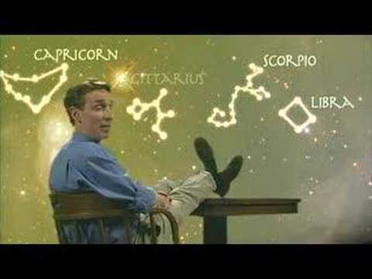
Video

Slide 34
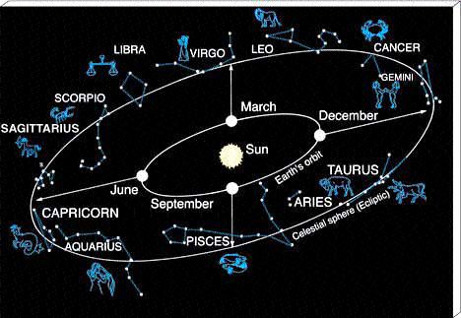
Zodiac Signs are based on Constellations! Night Side of the Earth

Slide 35
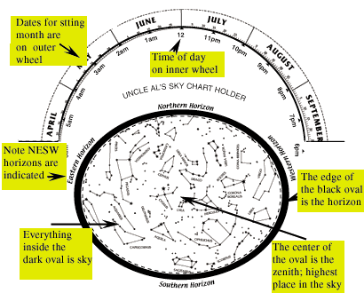
Star Wheels

Slide 36
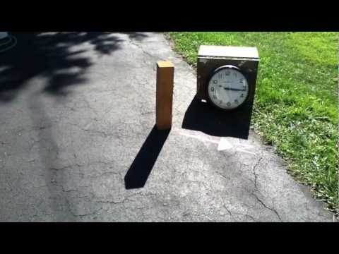
Video - Shadow Time of Day

Slide 37
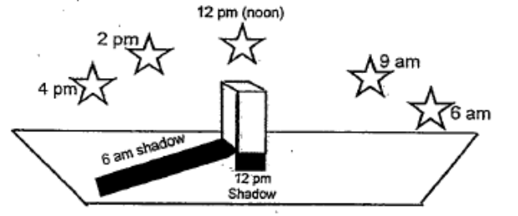
Shadows - Time of Day

Slide 38
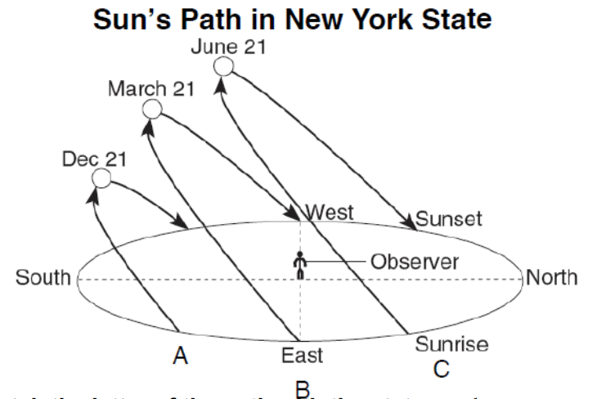
Shadows - Time of Year

Slide 39
Questions
What is different about the real Earth and Sun from our Earth and Sun?
Did we use the angle of insolation or the latitude for our thermometers?
As the latitude increases, what happens to the angle of insolation?

Slide 40
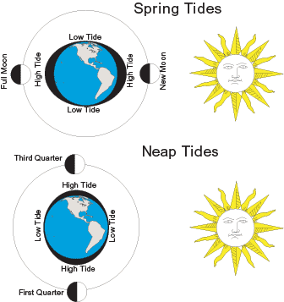
Lab

Slide 41
Video
https://www.youtube.com/watch?v=7UMsEqNDZu8

Slide 42
Finding Polaris Video
https://www.youtube.com/watch?v=7DjJ3r4XG0E

Slide 43
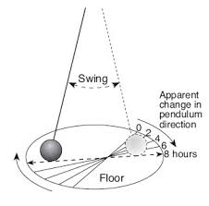
Coriolis Effect (Earth’s Rotation)
BECAUSE THE EARTH IS ROTATING

Slide 44
Coriolis Effect - Live Stream
http://www.geophysik.uni-muenchen.de/outreach/foucault-pendulum

Slide 45
https://www.youtube.com/watch?v=iqpV1236_Q0

Slide 46
Turn and Talk
What is redshift and blueshift?
What does it tell us?

Slide 47
Video
https://www.youtube.com/watch?v=8FPVIV-LzYM

Slide 48
Latitude and Longitude Activity
On graph paper:
Choose your scale (Ex: Latitude 10º; longitude 15º)
Start at latitude 0º and longitude 0º (both down the middle of your paper)
Mark each box your scale starting from latitude and longitude 0º (what does latitude go to? longitude?)
Draw a box around your map and draw each latitude and longitude

Slide 49
Latitude & Longitude Cont.
Plot 5 points anywhere on your map and label them 1-5 (at intersections)
Hand it to the person to your right
On the back of the graph paper write 1-5 and find the latitude and longitude of their 5 points

Slide 50
On a scrap piece of paper write your name and answer the question:
How are latitude and longitude lines drawn on a globe of Earth?
Latitude lines are parallel and longitude lines meet at the poles.
Latitude lines are parallel and longitude lines meet at the equator.
Longitude lines are parallel and latitude lines meet at the poles.
Longitude lines are parallel and latitude lines meet at the equator.

Slide 51
Videos
https://www.youtube.com/playlist?list=PL8A2171FA17D43A35

Slide 52
Review for Benchmark #2
Greater Mass = Greater force of Gravity.
EM Spectrum: Radio Waves have the highest wavelength, gamma rays the lowest.
High Tide → 6 hours, 12 mins → Low Tide (Repeats as a cycle due to Earth’s rotation)
Earth’s rotation: stars appear to circle around Polaris at night.
Earth’s Revolution: diff. seasons, diff. constellations
5. Coriolis Effect and Foucault Pendulum: Evidence for Earth’s ROTATION.

Slide 53
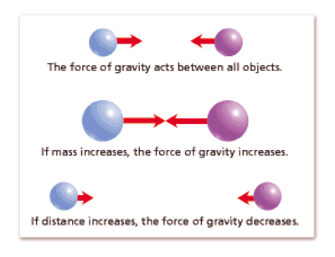
What affects gravity?

Slide 54
Where can this electromagnetic Spectrum be found?

Slide 55
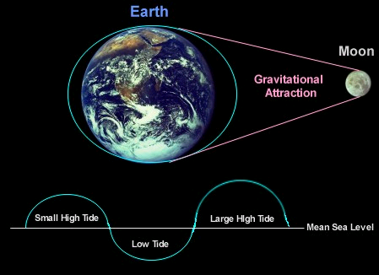
What causes Tides?

Slide 56
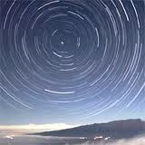
What causes star paths?

Slide 57
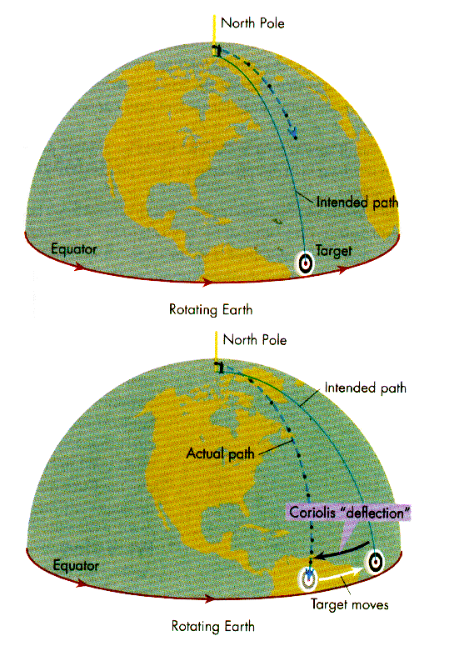
Coriolis Effect

Slide 58
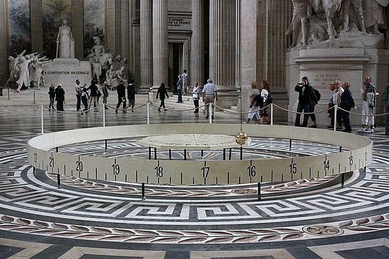
Foucault Pendulum
http://www.youtube.com/watch?v=nB2SXLYwKkM

Slide 59
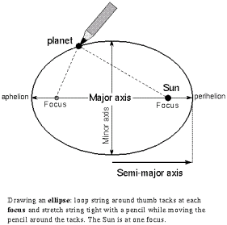
How do you find eccentricity?

Slide 60
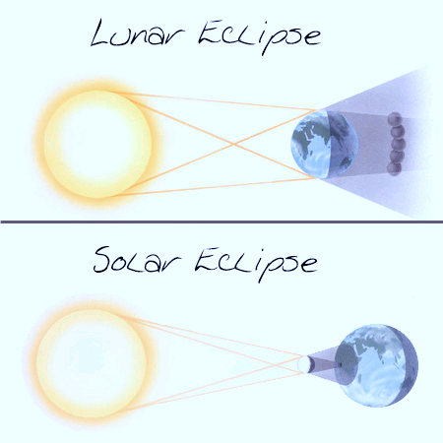
What are each eclipses?

Slide 61
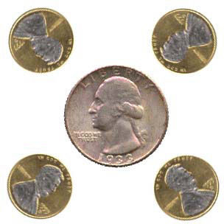
Why does the same side of the moon always face the Earth?
Because the period of moon’s rotation equals the period of moon’s revolution!!!
http://www.youtube.com/watch?v=OZIB_leg75Q

Slide 62
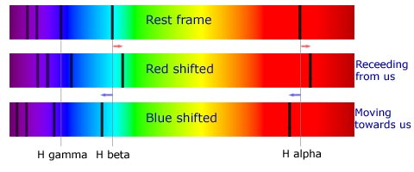
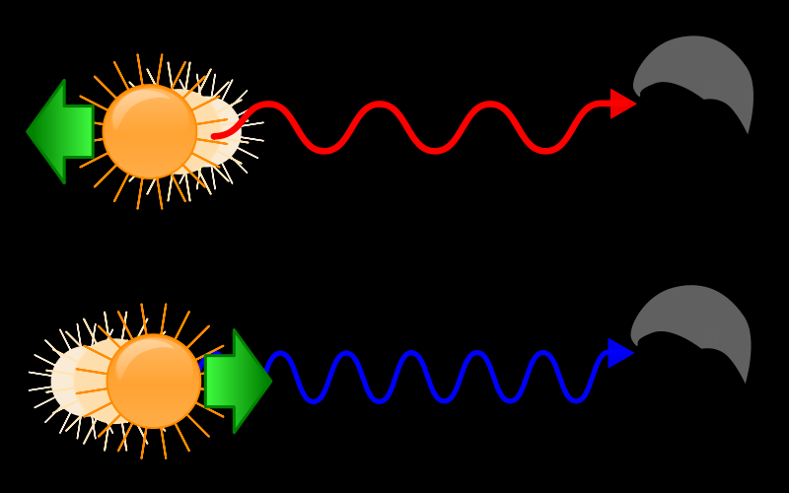
What is red shift/blue shift?

Slide 63
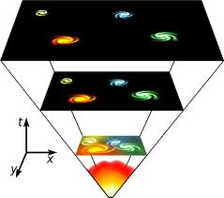
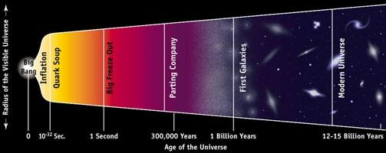
What is the Big Bang?
The Universe is about 13.7 billion years old.

Slide 64
Remember (Be Confident!)
Read ALL information and diagrams before trying to answer a question.
Take your time, rushing causes foolish mistakes.
THINK about what the question is asking you.
Go with your instincts. These are NOT trick questions, sometimes they just have more information than you need.

Slide 65
Last Tip
When a Regents question asks you to “COMPARE” two numeric values. All you have to do specifically indicate which one is higher.
For example: Outside Temp = 30°
Inside Temp = 70°
Compare the temperatures.

