Slide 1
Erosion by Glaciers

Slide 2
Glaciers:
Area completely covered by ice/snow all year.

Slide 3
Conditions Necessary:
Climate: More snowfall than melting.
Latitude/Elevation: Equator’s mountains can have glaciers.
Gravity: Pulls down ice/snow.
Glaciers always move down hill.

Slide 4
Glacial Movement
“Advancing”: More snowfall than melting.
“Retreating”: More melting than snowfall.

Slide 5
Jakobshavn, Greenland: Retreat

Slide 6
Glacial Movement
Glaciers always move faster in the center and near glacier surface (less friction).

Slide 7
Glacial Movement

Slide 8
Types of Glaciers
Continental Glacier: Ice sheets, found in polar regions, can cover entire continent.

Slide 9
Valley (Alpine) Glaciers
Contained within valleys between mountains (e.g. Franz Josef).

Slide 10
Carrying power of a Glacier
Sediment size: Anything from clay to boulders.
All sediments carried by a glacier are called drift.
Three types of drift: Till, Glacial Erratic, Outwash.

Slide 11
Till
Unsorted, unstratified, deposited directly by melting ice.

Slide 12
Glacial Erratic
Large boulder deposited by itself.
Sandstone on granite mountain in NJ -----→

Slide 13
Outwash
Sediment deposited by melt waters, sorted and stratified.

Slide 14
Glacial Evidence
Sediment polishes and scratches bedrock through abrasion.
Glacial Striations: Scratches on bedrock caused by sediments on the bottom of glacier.

Slide 15
Glacial Striations

Slide 16
Glacial Striations?

Slide 17
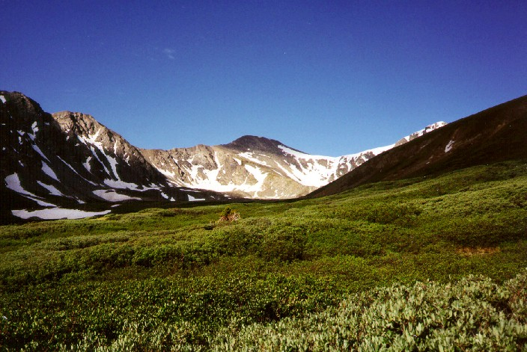
Glacial Erosion
Glaciers carve U-Shaped Valleys

Slide 18
Finger Lakes

Slide 19
What created this valley?

Slide 20
Glacial Erosion
In Continental glaciers, topography of an area is rounded off.

Slide 21
Erosional Features of Glaciers
Cirque: Semi-circular basin at head of glacier.
2 cirques form an arete.
3 cirques form a horn.

Slide 22
3 cirques

Slide 23
Erosional Features of Glaciers
Glacial Trough: Valley formed by a glacier (U).
Hanging Trough: Valley formed by a higher glacier that meets the main glacier.

Slide 24
Glacial Troughs

Slide 25
Drumlin
Upside down canoe-shaped mound of till. Steep side faces direction of glacial retreat. Gentle side faces direction ice advanced.

Slide 26
Which way did the glacier advance?

Slide 27
Syracuse University

Slide 28
Topographic Map

Slide 29
Moraines: Ridges of till
Lateral Moraine: Located on the sides of the glacier.
Medial Moraine: Located in the middle, form from two glacier joining.
Ground Moraine: On the ground, throughout the valley.

Slide 30
Moraines (Continued)
End Moraine: Formed at the end of glacier.
Terminal Moraine: Farthest extent of the glacier.
Recessional Moraine: Formed where glacier stalls and sits.

Slide 31
2 More Erosional Features
Eskers: Long, winding ridges.
Kettle Lakes: Formed from a block of ice buried in sediment, usually no outlet/inlet.
Example: Tully Lakes

Slide 32
The Glacial Deposits

