Slide 1
Latitude and Longitude
?
within
NEW YORK STATE
Mr. DeMarco

Slide 2
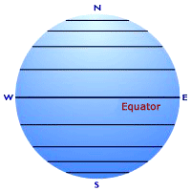
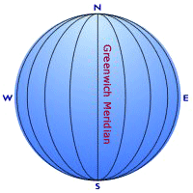
What do we know already?
Latitude lines run east and west across the Earth. They measure how far a location is north or south of the 0º line called the Equator.
Longitude lines run north and sound across the Earth. They measure how far a location is east or west of the 0º line called the Prime Meridian.

Slide 3
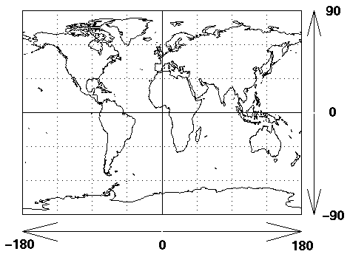
Places on Earth have an address.
NW
NE
SW
SE

Slide 4
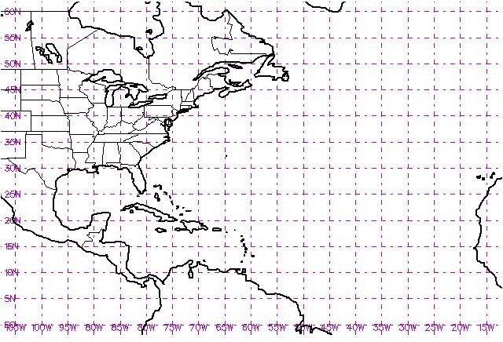
When locating much smaller areas, such as lakes, cities, or mountains, it becomes necessary to use more specific, more detailed coordinates.
Perhaps by looking at a smaller scale map, we can see how a more specific form of latitude and longitude can be useful.
See your city? Nope.
Places in New York State
are too small to see
on this scale!

Slide 5
Go to…
Earth Science Reference Tables
Page 3
We will be sharpening our understanding of latitude and longitude to locate places within NYS, and more importantly, be able to be more precise and exact when describing locations anywhere on Earth!

Slide 6
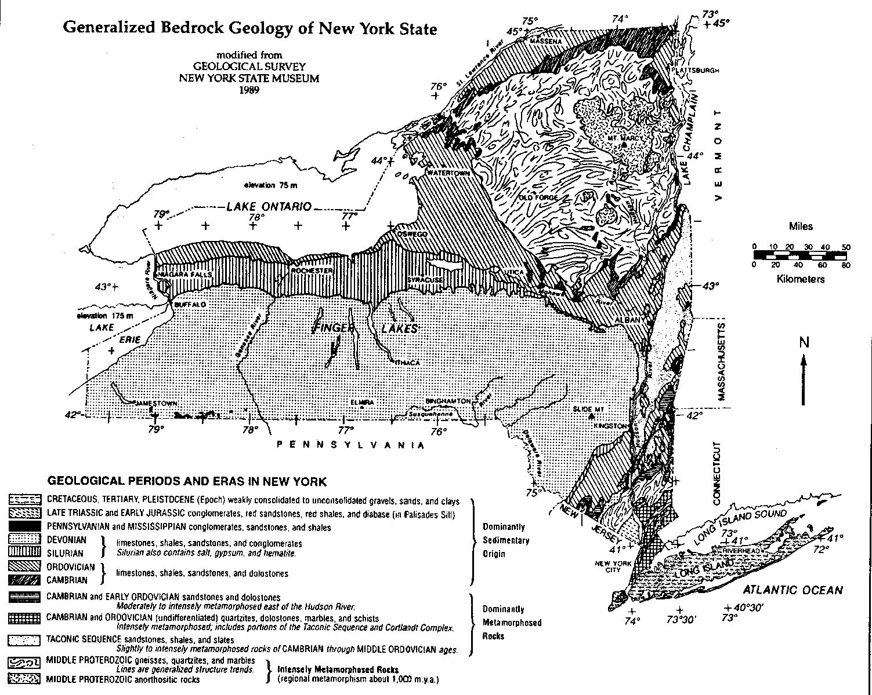

Slide 7
45°N
44°N
43°N
42°N
41°N
79°W
78°W
77°W
76°W
75°W
74°W
73°W

Slide 8
Seems like a nice grid.
*It just needs to get a little more specific!*
Let’s do it!

Slide 9
ZOOM IN

Slide 10
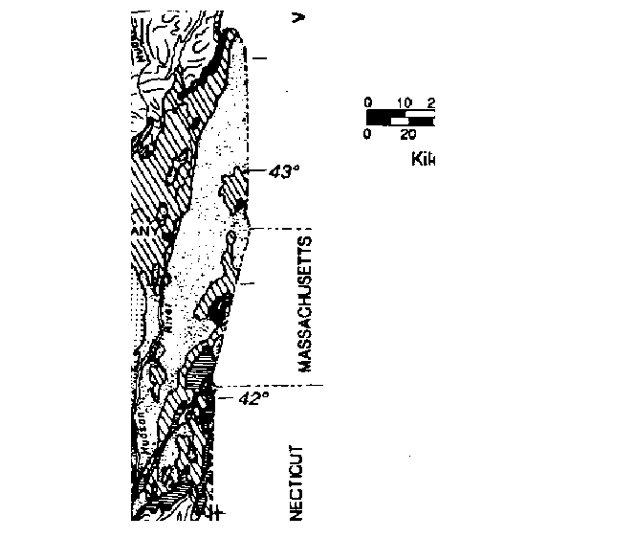
I’ll delete this text so we have a clear picture of the map’s edge.

Slide 11
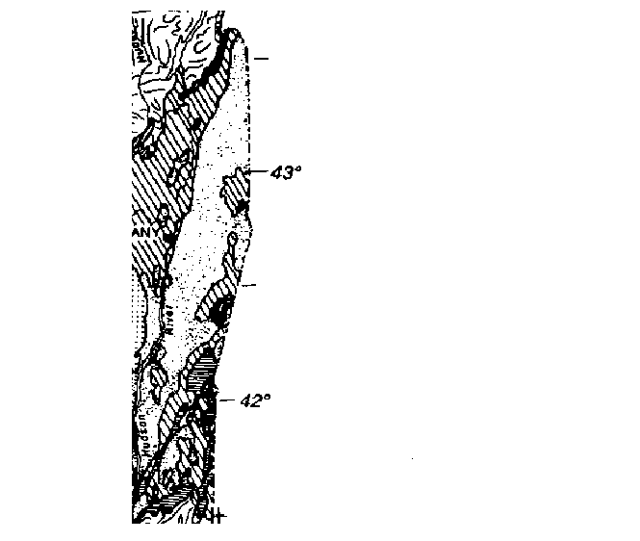
We can now clearly see that there are increments on the side of our map. In this particular section of the map, we notice 42º and 43º clearly marked up the side of the map. The increments are marked in “Degrees.”
More specifically,
degrees NORTH of the Equator!
43
42

Slide 12
This ONE DEGREE difference in LATITUDE is broken down into smaller increments in order to name locations that may fall between degree marks.

Slide 13
Just like one hour, one degree has 60 minutes in it!
We now can now use:
Degrees, and Minutes!
By using minutes, we divide this one degree spread into 60 minutes.

Slide 14
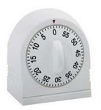
This mark that separates the one degree spread in half is 30 minutes!
42º 30’
You would say:
“forty two degrees, thirty minutes”
Think of 1 hour
as 1 degree.
degrees minutes
30 minutes would
be half way!

Slide 15
0 minutes
45 minutes
30 minutes
15 minutes
0 minutes

Slide 16
0 minutes
50 minutes
40 minutes
30 minutes
20 minutes
10 minutes
0 minutes

Slide 17
Latitude
This makes finding a location in something like a State much easier and more accurate. It essentially creates a grid, just like lat/long lines, but much smaller!
Longitude

Slide 18
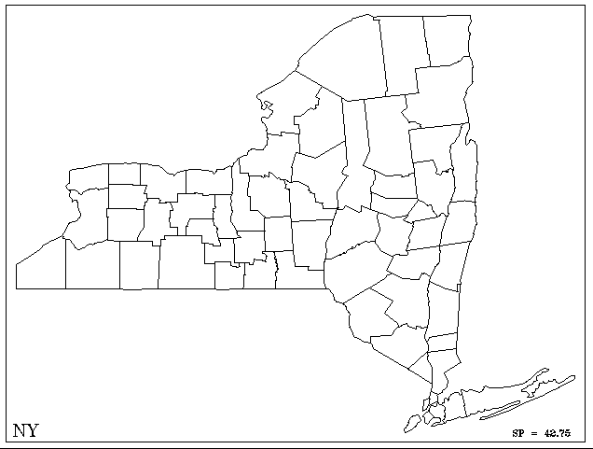
Reminder:
The lines that measure how far “up or down” on the map are lines of latitude, and are recorded as NORTH OR SOUTH of the equator. This gets recorded FIRST.
The lines that measure how far “left or right” on a map are lines of longitude, and are recorded as EAST OR WEST of the prime meridian.

Slide 19
Let's find one together!
Location of Ithaca?

Slide 20
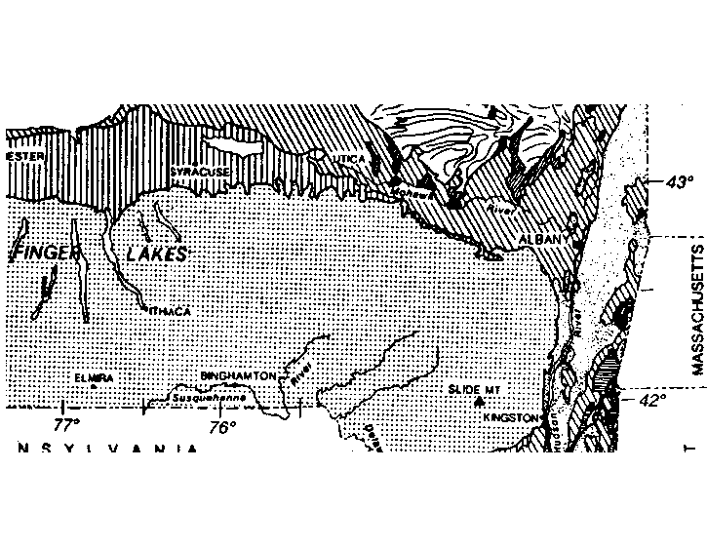
?
?
Record your answer on scrap paper.

Slide 21
Is your answer...
42º 20’ N 76º 30’ W
?

