Slide 1
Mechanical or Chemical Weathering?
Limestone Statue

Slide 2
Mechanical or Chemical Weathering?

Slide 3
Mechanical or Chemical Weathering?

Slide 4
Mechanical or Chemical Weathering?

Slide 5
Mechanical or Chemical Weathering?

Slide 6
Mechanical or Chemical Weathering?

Slide 7
Mechanical or Chemical Weathering?

Slide 8
Mechanical or Chemical Weathering?

Slide 9
Mechanical or Chemical Weathering?

Slide 10
Mechanical or Chemical Weathering?

Slide 11
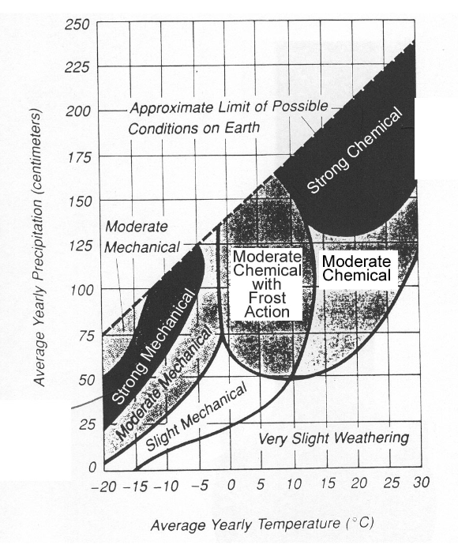

Slide 12
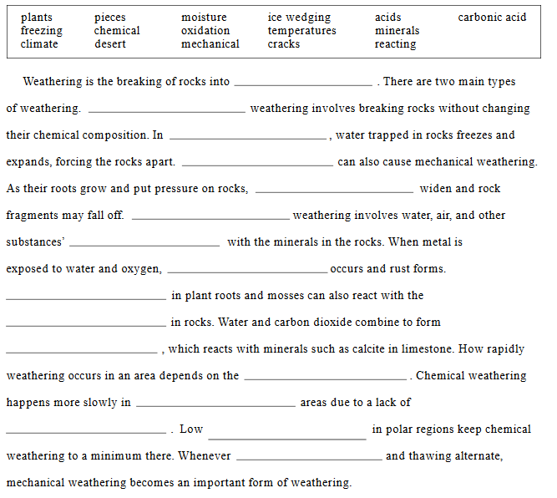

Slide 13
Products of Weathering

Slide 14
Sediments
Weathered rock particles.

Slide 15
Sediment Sizes
Arrange these particles from largest to smallest: Sand, Pebble, Clay, Boulder, Cobble, Silt

Slide 16
Page 6 of ESRT

Slide 17
Sediment Size (Continued)
Boulder: 25.6cm and greater
Cobble: 6.4 – 25.6cm
Pebble: 0.2 – 6.4cm
Sand: 0.006 – 0.2cm
Silt: 0.0004 – 0.006cm
Clay: Less than 0.0004cm

Slide 18
Soils
Two components: weathered rock and organic matter

Slide 19
Soils (Continued)
Parent Material: The rock the soil comes from.
Residual Soil: Bedrock is the parent material.
Transported Soils: Moved by water, winds, or glaciers.

Slide 20
Residual Soil

Slide 21
Transported Soil
Often layers of “sorting” when deposited by streams
Poorly sorted when deposited by glaciers

Slide 22
Soil Profile
Side view of soil layers.
Mature soil: Four zones or Horizons

Slide 23
Put the four horizons in order (Top to Bottom)
A-Horizon: Highly decomposed organic matter and small rock particles (sand or smaller), leaching of minerals to lower layers.
B-Horizon: Larger rock particle, clays and little organic matter, leached minerals deposit in this layer, giving it a reddish brown/tan color.
C-Horizon: Consists of partly weathered bedrock.
O-Horizon: Composed of organic matter, dark brown to black in color
R-Horizon: Unaltered bedrock

Slide 24
Soil Profile (Continued)
Not all soil horizons are always clearly present.

Slide 25
1) O-Horizon
2) A-Horizon
3) B-Horizon
4) C-Horizon
5) R-Horizon

Slide 26
Soil Profile
O-Horizon: Organic matter, dark brown to black.
A-Horizon: Very decomposed organic matter and small rock particles (sand or smaller), minerals have been leached.
B-Horizon: Larger rock particles, clays and little organic matter, deposited minerals cause reddish brown/tan color.
C-Horizon: Consists of partly weathered bedrock.
R-Horizon: Bedrock.

Slide 27
Soils are influenced by Climate
Tropical soils: Minerals leached out by rainfall.
Desert soils: Mineral rich
Arctic soils: Poorly drained, permafrost
Forest soils: O-Horizon is most prominent, yearly leaf collection.

