Slide 1
Bill Nye Rocks and Soil

Slide 2
ROCKS! ROCKS! ROCKS!
Rocks are made of minerals

Slide 3
Rocks
A rock is a mixture of minerals
Rocks can be:
Monomineralic
Made of just one mineral
Example: rock salt (Halite)
Polymineralic
Made of more than one mineral
Example: Granite

Slide 4
TYPES OF ROCKS
Rocks are classified based on their environment of formation
What are rocks classified based on?
Three Types
Igneous Rocks
Sedimentary Rocks
Metamorphic Rocks

Slide 7
Igneous Rocks
Form from cooling of molten rock (lava or magma)
2 kinds:
Intrusive (Plutonic)
Cool slowly, deep below the surface
FORM LARGE INDIVIDUAL CRYSTALS
Extrusive (Volcanic)
Cool quickly, at or near the surface
Form small crystals or no crystals

Slide 8
Igneous Rock Identification
Chemical Composition
Felsic: light colored, low density
Mafic: dark colored, high density
Texture- CRYSTAL SIZE
Course-grained - large crystals
Fine-grained - small crystals
Glassy - no visible crystals
Porphyry - large crystals surrounded by a fine grained mass

Slide 9
Intrusive: Cooled Slowly, Coarse-grained rock = large crystals

Slide 10
Extrusive: Fine-grained

Slide 11
Obsidian: Extrusive or Intrusive? It is an extrusive, fine-grained, igneous rock.

Slide 12
Vesicles (gas holes) = Igneous Rock
Vesicular: Small holes created by the escape of gas bubbles from cooling lava.

Slide 13
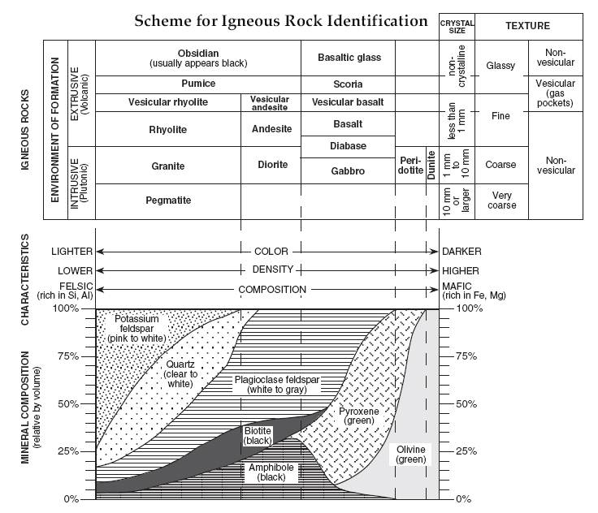

Slide 14
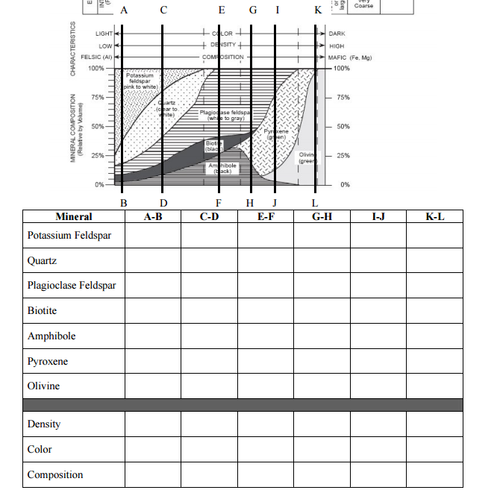

Slide 15
Sedimentary Rock

Slide 16
Sedimentary Rocks
Form from sediments that are compacted and/or cemented together (the 2 C’s)
Divided into three groups
Clastic
Chemical
Organic

Slide 17
Clastic Sedimentary Rocks
Formed from compaction and cementation of rock fragments (clasts)
Natural Cements on Earth include: dissolved lime (calcite) and clays

Slide 18
Cemented Conglomerate

Slide 19
Chemical Sedimentary Rocks
Form from minerals in water deposited during precipitation and evaporation
Always monomineralic, made only of one mineral
Examples:
Calcite/Dolomite - react with acid
Halite - tastes salty
Gypsum - has cleavage, soft

Slide 20
Organic Sedimentary Rock (Bioclastic)
Form from once living organisms
Fossils: preserved shells
Can be made up of entirely shell fragments

Slide 21
Sedimentary Rock Identification
Sedimentary rocks are the ONLY rocks that contain fossils
Clastic Rocks – Use TEXTURE
Pebbles, sand, silt, clay size sediment?
Chemical Rocks – Use Composition
Calcite, halite, gypsum or dolomite
Organic Rocks – Use Composition
From plants or animals (shells)

Slide 22
Features of Sedimentary Rocks
Stratification
Layers or beds of rock
Fossils- remains or impressions of once living things preserved in rock
Ripple Marks
Formed by waves
Mud Cracks
Clay cracks when it dries
Nodules - chert
Water: ALWAYS PRESENT IN THE FORMATION OF SEDIMENTARY ROCKS

Slide 23
Chiroptera Fossil

Slide 24
Turn and Talk
How are sedimentary rocks formed?

Slide 25
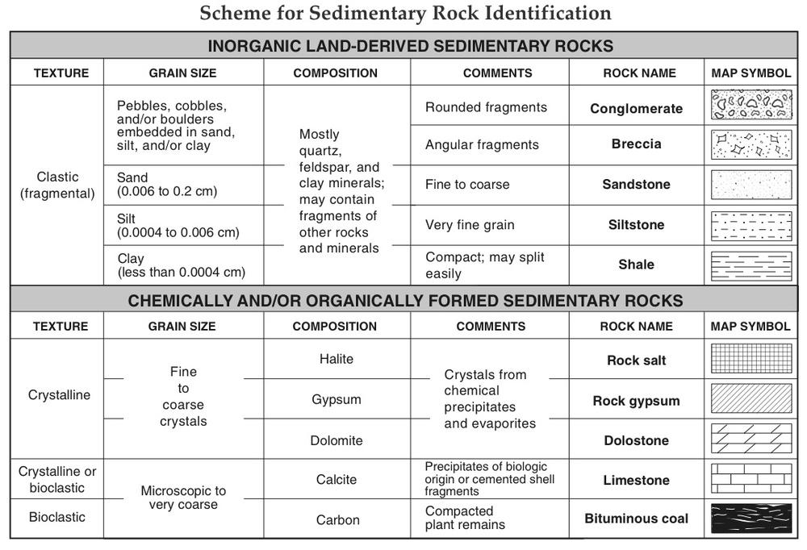

Slide 26
Metamorphic Video

Slide 27
Turn and Talk
What does the word morph mean?
How are metamorphic rocks formed?
What happens to them when they are formed?
What are the two main types of metamorphic rocks?

Slide 28
Metamorphic Rocks
Form from existing rocks that are changed by heat and/or pressure
Two Types of Metamorphism
Regional - large area under intense heat and pressure - found in mountainous areas
Thermal or Contact - located near magma that heated the existing rock

Slide 29
Features of Metamorphic Rocks
Foliation - bands of minerals that form from recrystalization
Density - pressure causes the rocks to become more dense
Alignment: Minerals become aligned
Distortion- mineral bands or fragments become bent or wavy due to pressure

Slide 30
Metamorphic Rock Identification
Foliated or Nonfoliated
Look for banding and distortion
Probable Rock Origin
What igneous or sedimentary rock does it look like?
Composition
Determine the minerals present
Acid Test for Calcite?

Slide 31
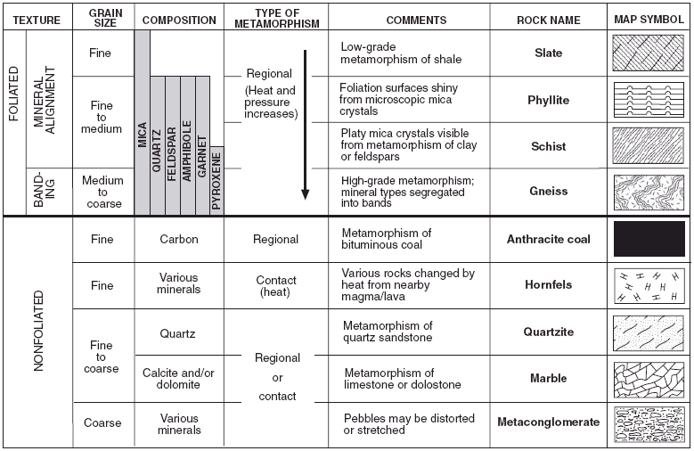

Slide 32
Rock Classification

Slide 33
Rock Cycle
Materials are constantly being cycled through the three rock types.
Melting: Igneous Rocks
Cementation/Compaction: Sedimentary Rocks
Heat/Pressure: Metamorphic Rocks

Slide 35
Turn and Talk
What process creates sediment?
What process creates metamorphic?
What process creates igneous?

Slide 36
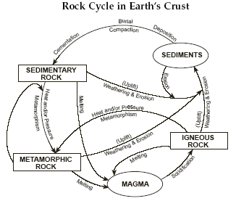

Slide 37
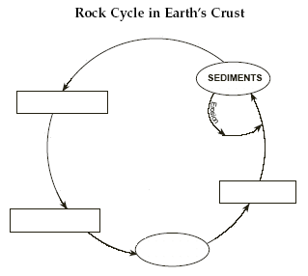

Slide 38
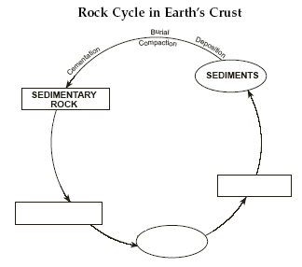

Slide 39
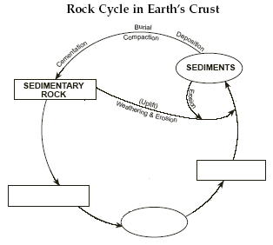

Slide 40
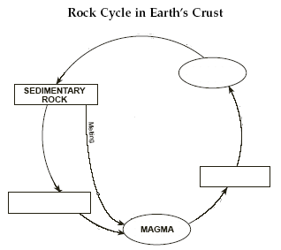

Slide 41
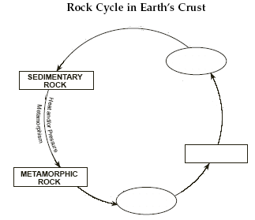

Slide 42
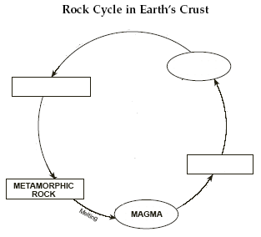

Slide 43
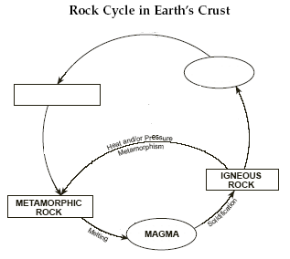

Slide 44
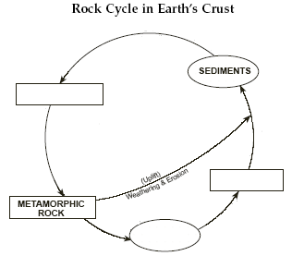

Slide 45
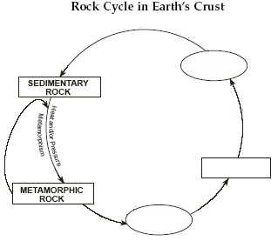

Slide 46
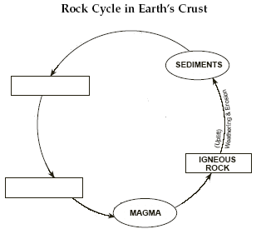

Slide 47
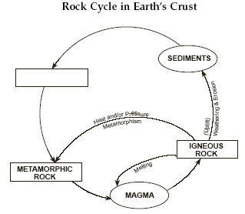

Slide 49
Clastic

Slide 50
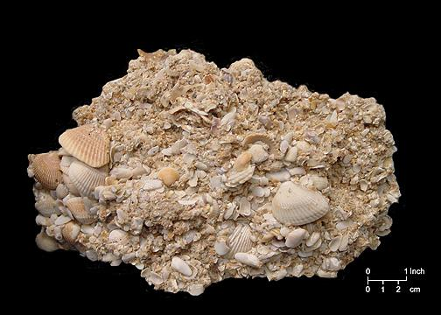
Organic

Slide 51
Chemical

Slide 52
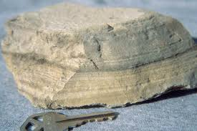
Stratification (Strata)

Slide 53
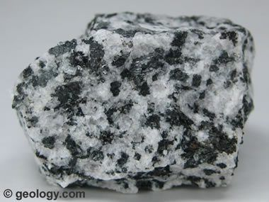
Coarse Grained

Slide 54
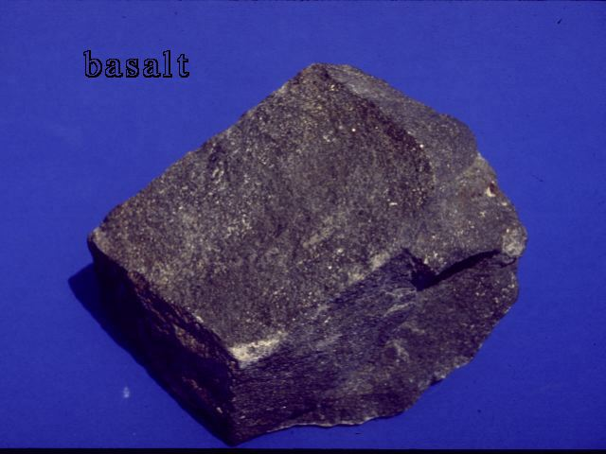
Fine Grained

Slide 55
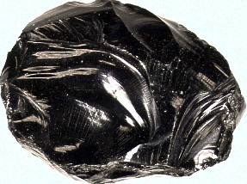
Glassy Texture

Slide 56
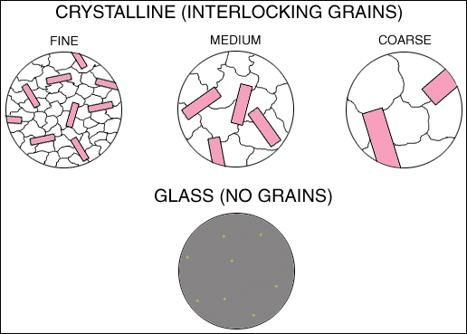

Slide 57
Metamorphic Rocks
Foliated
Layered bands
Distorted Structure
Layered bands are distorted
Garnet
Redish brownish gem
Mica
Pinkish clear gem

