Slide 1
Factors Effecting Weathering

Slide 2
Exposure
Rocks must be exposed to the atmosphere to weather.
How can soil and vegetation effect weathering?
They can protect from weathering.
Greater Exposure = Faster Weathering

Slide 3
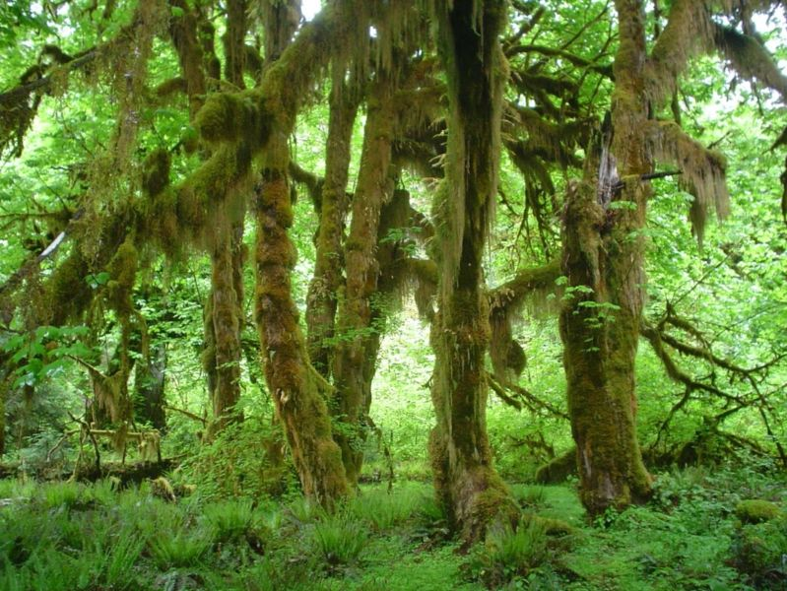
Which will weather faster? A

Slide 4
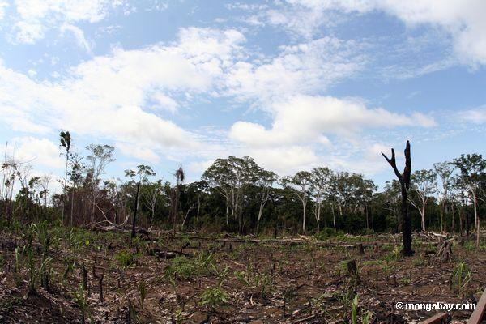
Which will weather faster? B

Slide 5
Mineral Composition
Determines rock sensitivity to weathering.
Depends on chemical reactions and hardness of mineral.

Slide 6
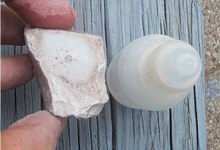
What rock is this?
Limestone: Breaks down (bubbles) with acid.

Slide 7
Granite
1) Feldspars: Eventually turn into clay minerals (easy to break apart)
2) Quartz: Is resistant to weathering, high hardness.

Slide 8
Particle Size
For the same mass, smaller particles have a greater surface area.

Slide 9
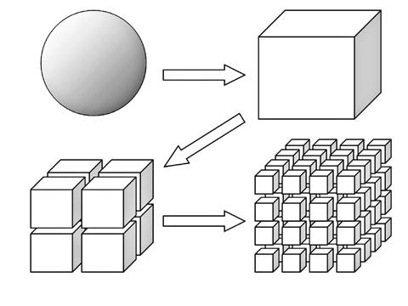
Smaller Particle Size = Greater Surface Area

Slide 10
Particle Size
The smaller the particle, the faster the weathering rate (because it has more surface area to react with chemicals)
Defines the relationship between mechanical and chemical weathering

Slide 11
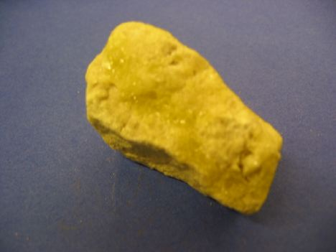
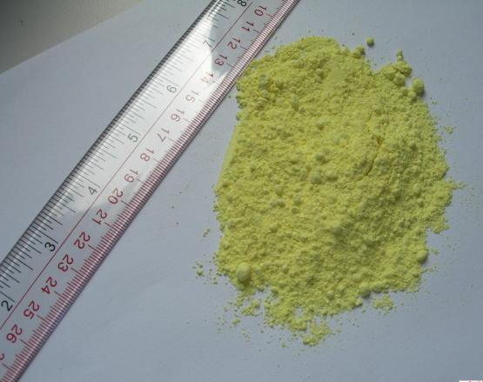
Which will weather faster?

Slide 12
Climate
Most important factor for type and rate of weathering.
Warm Climate: More chemical weathering.
Cold Climate: Mostly frost action (not in polar regions)
Add moisture (precipitation): More weathering

Slide 13
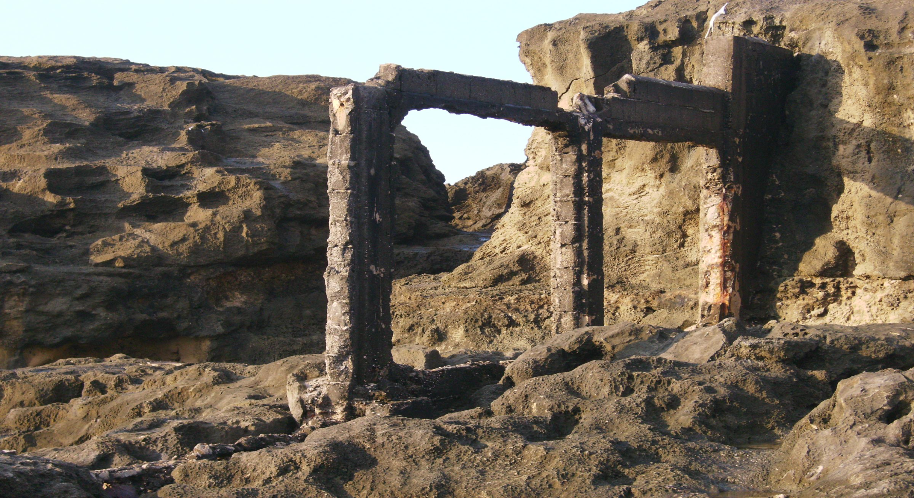
Manati, PR

Slide 14
Time
Longer exposure = More weathering.

